Slide 1
Graph Models
CSCI-347 Data Mining

Slide 2
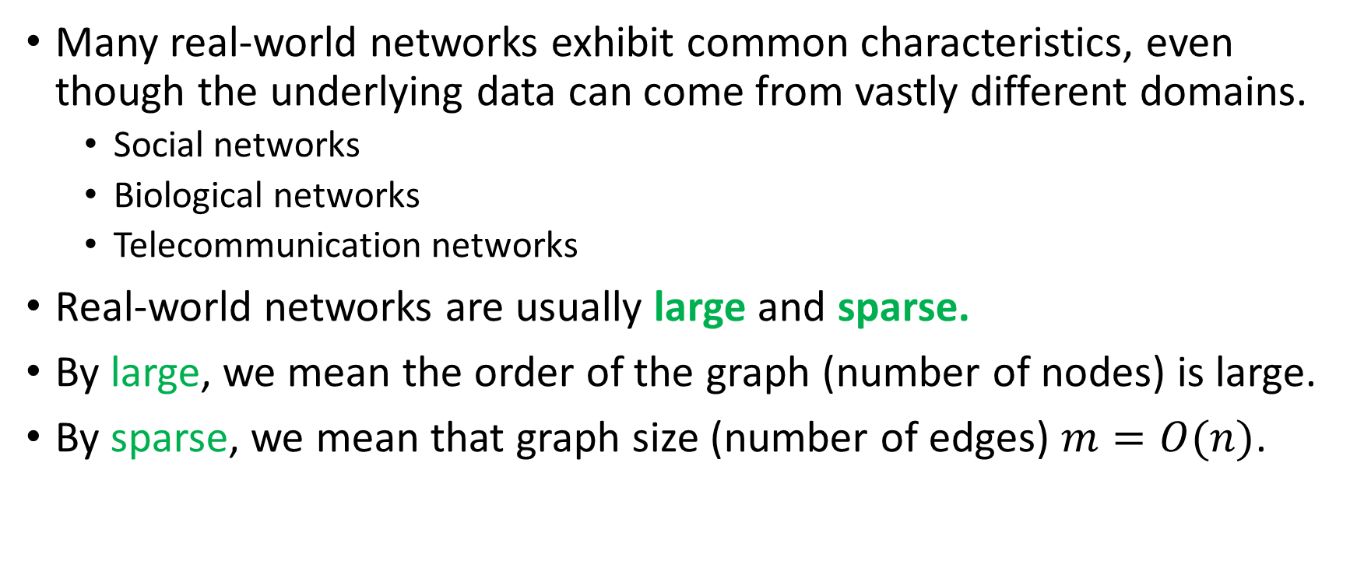
Real-world graph properties
Many real-world networks exhibit common characteristics, even though the underlying data can come from vastly different domains.
Social networks
Biological networks
Telecommunication networks
Real-world networks are usually large and sparse.
By large, we mean the order of the graph (number of nodes) is large.
By sparse, we mean that graph size (number of edges) $m=O(n)$.

Slide 3
Real-world graph properties
What kind of underlying processes enables graphs to have these properties?
We will look at few different measures that will allow us to compare and contrast real-world networks.

Slide 4
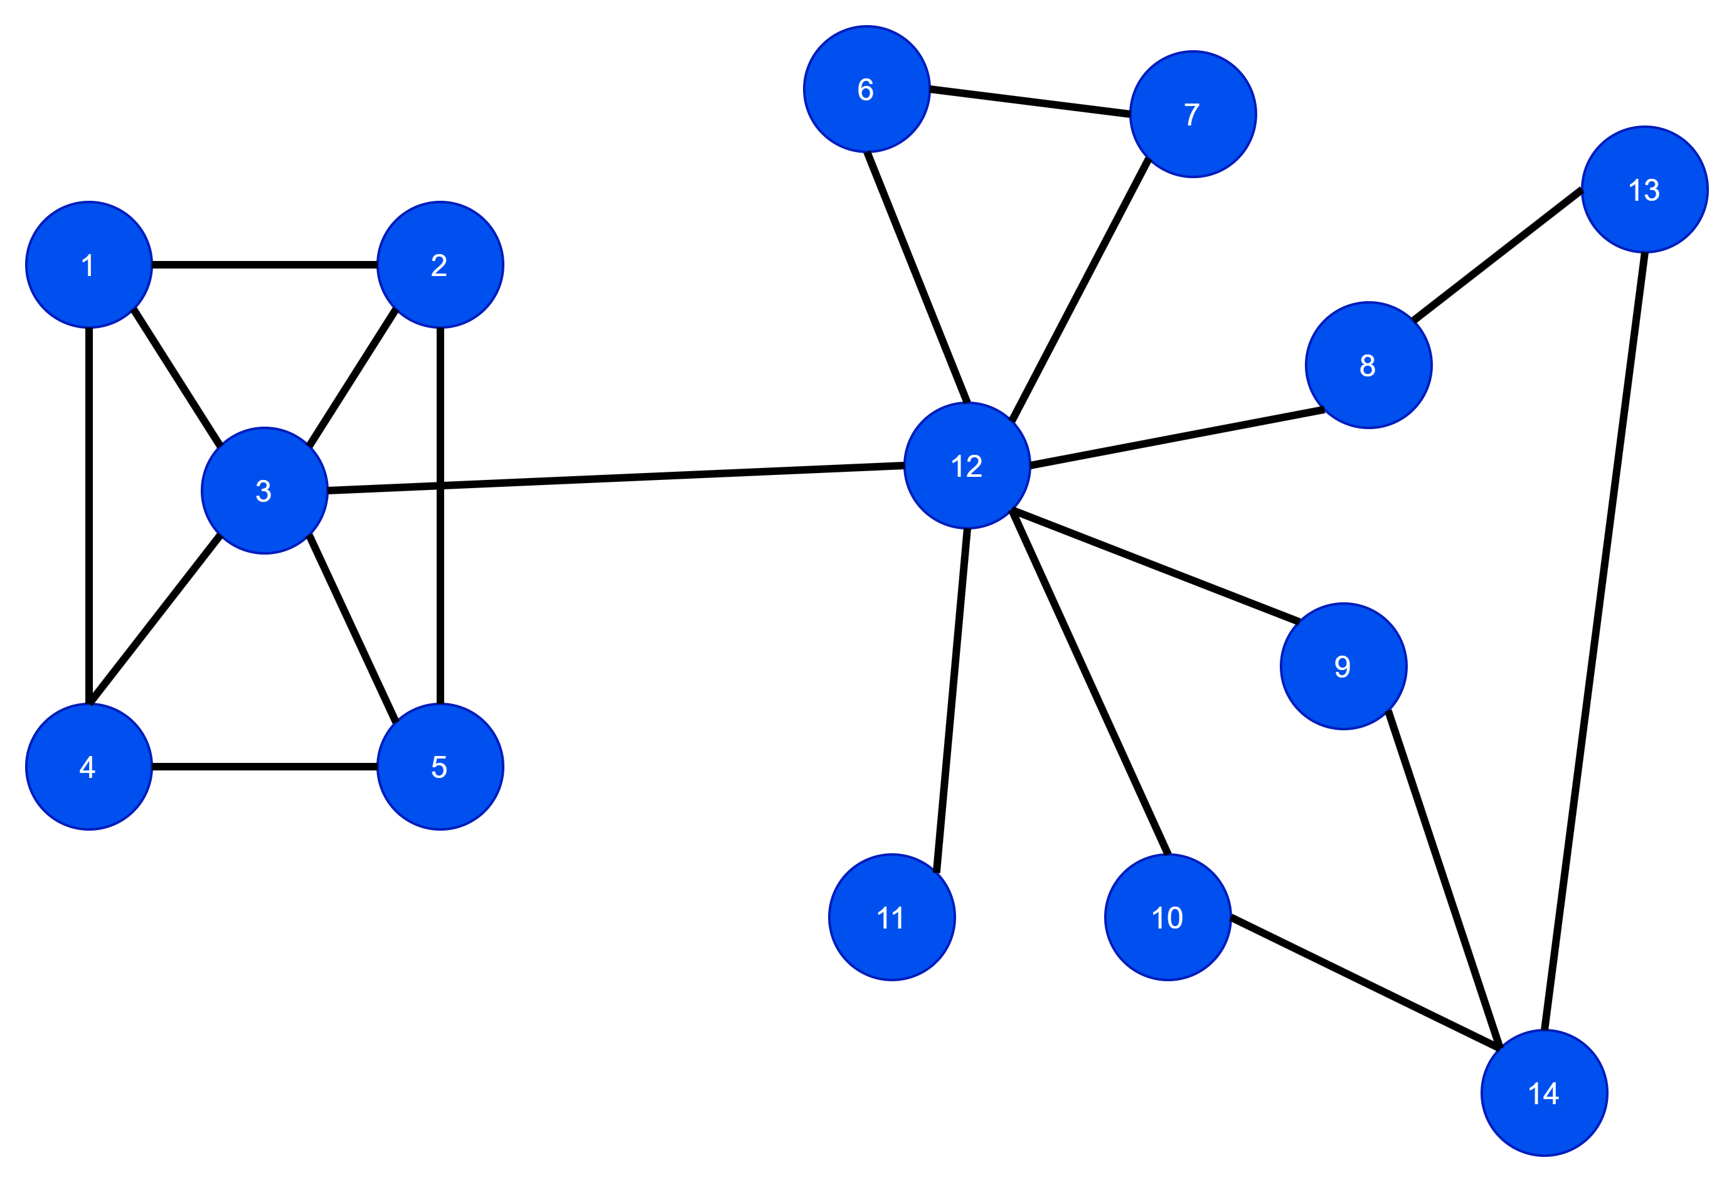
Real-world properties
Small-world property
Scale-free property
Clustering effect

Slide 5
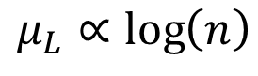
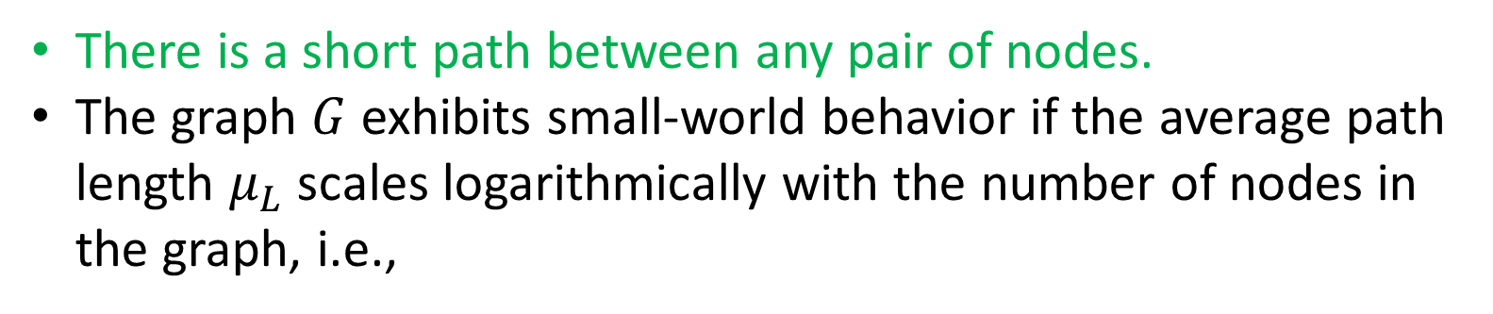
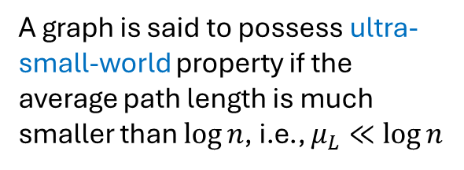
Small-world property
There is a short path between any pair of nodes.
The graph $G$ exhibits small-world behavior if the average path length $μ_{L}$ scales logarithmically with the number of nodes in the graph, i.e.,
A graph is said to possess ultra-small-world property if the average path length is much smaller than $\log{n}$, i.e., $μ_{L}≪\log{n}$
$$μ_{L}∝\log\left(n\right)$$

Slide 6
Six degrees of separation
The Six Degrees of Separation theory suggests that any two people in the world are connected through at most six social connections (or "degrees").
This means you can reach anyone—whether it's a celebrity, a politician, or a stranger in another country—through a chain of at most six intermediaries.
Modern research, including studies using Facebook and LinkedIn, suggests the actual number may be closer to 4 or 5 degrees due to social media.

Slide 7
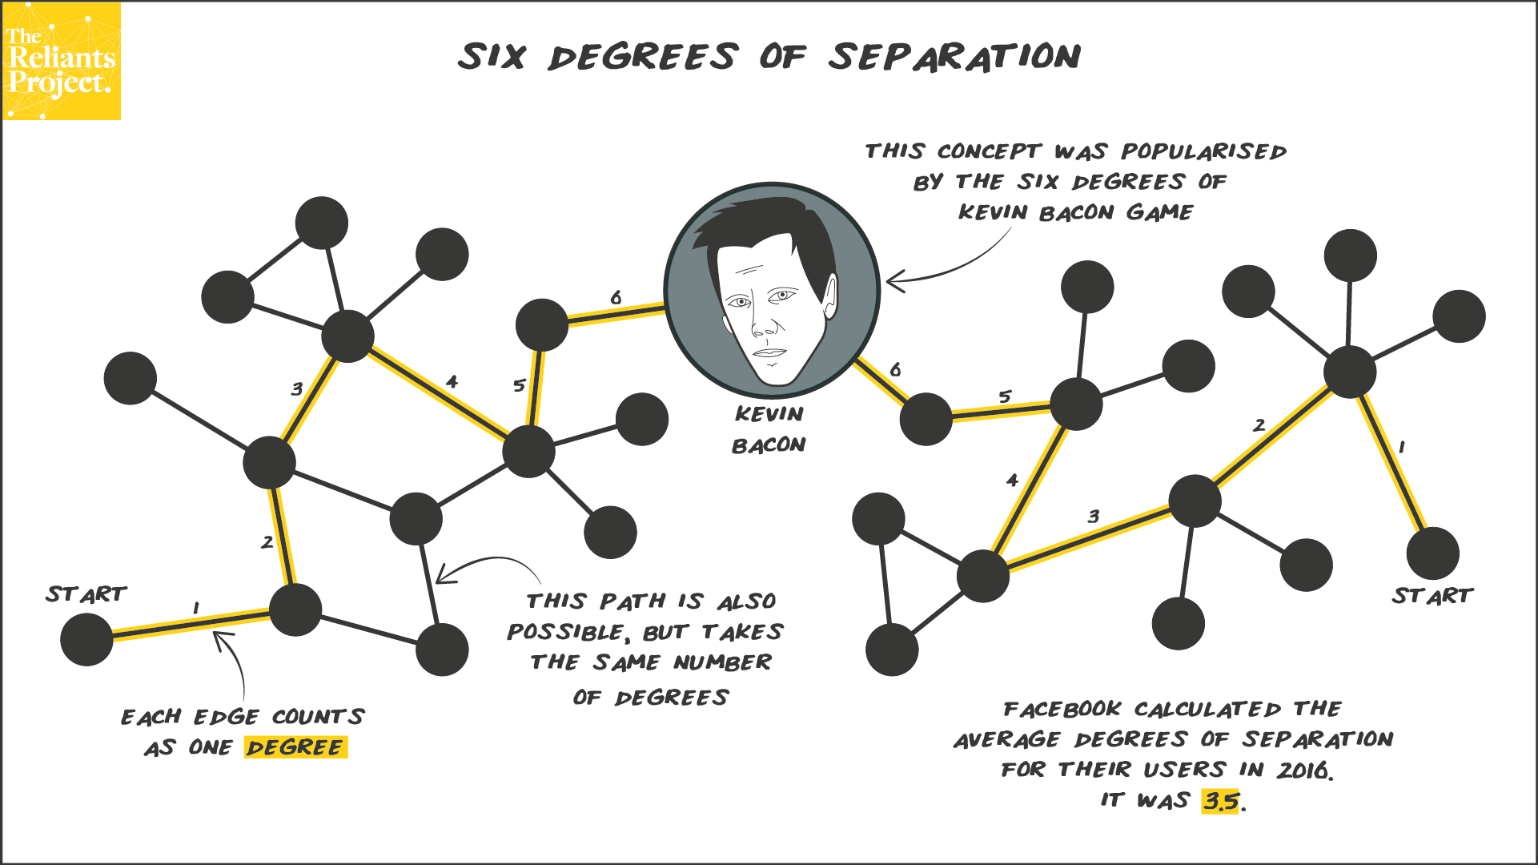
It measures how closely connected an actor is to Kevin Bacon based on shared film appearances.
https://www.reliantsproject.com/2020/06/13/concept-7-kevin-bacon-and-six-degrees-of-separation/

Slide 8
The Oracle of Bacon
Fun application of 6 degrees of separation
Go to https://oracleofbacon.org/movielinks.php

Slide 9
Small-world property
The Six Degrees of Separation exists because of the small-world property.
Small-world networks have high clustering coefficient and short average path lengths.

Slide 10
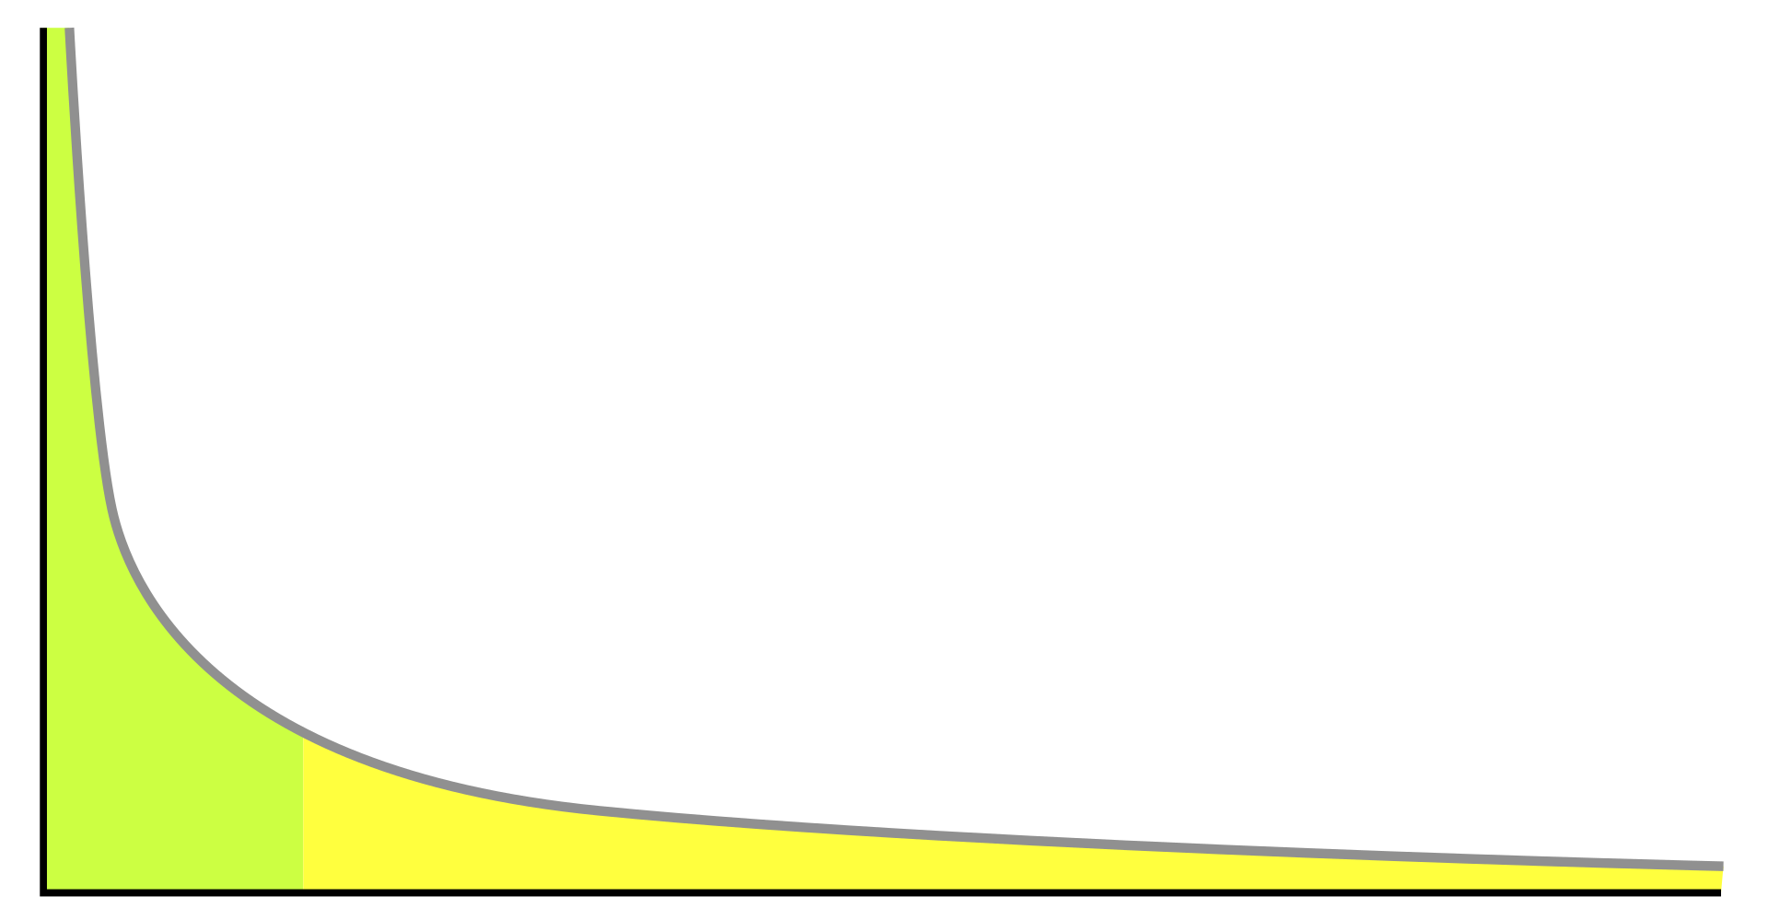
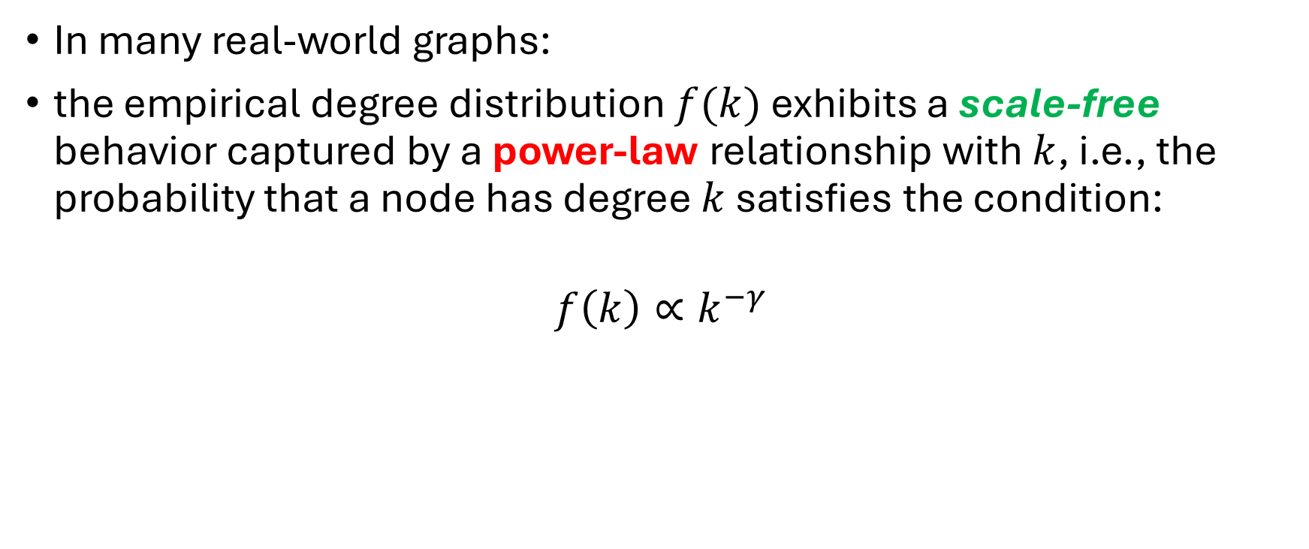
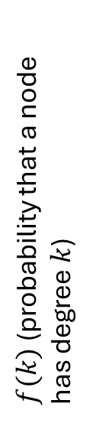
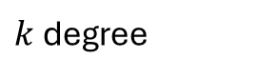
Scale-free property
In many real-world graphs:
the empirical degree distribution $f(k)$ exhibits a scale-free behavior captured by a power-law relationship with $k$, i.e., the probability that a node has degree $k$ satisfies the condition:
$$f\left(k\right)∝k^{−γ}$$
$f(k)$ (probability that a node has degree $k$)
$f\left(k\right)=probability that a node has degree k$
$k$ degree

Slide 11
Scale-free property
a power-law indicates that the vast majority of nodes have very small degrees.
Few “Hub” nodes have high degree—they connect to or interact with lot of nodes.

Slide 12
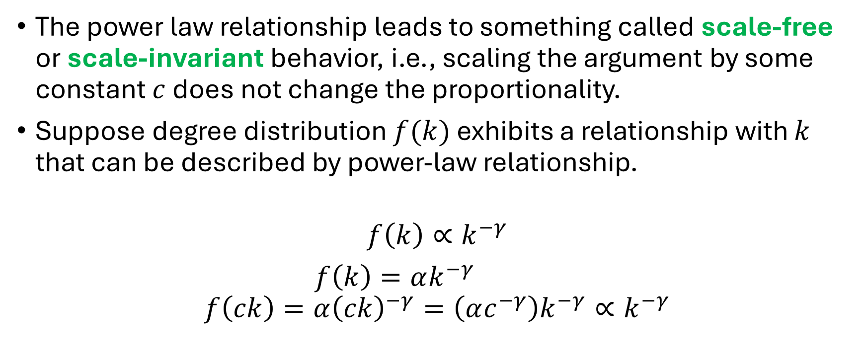
Why is this called scale-free?
The power law relationship leads to something called scale-free or scale-invariant behavior, i.e., scaling the argument by some constant $c$ does not change the proportionality.
Suppose degree distribution $f(k)$ exhibits a relationship with $k$ that can be described by power-law relationship.
$$f\left(k\right)∝k^{−γ}$$
$f\left(k\right)=αk^{−γ}$
$$f\left(ck\right)=α{\left(ck\right)}^{−γ}=\left(αc^{−γ}\right)k^{−γ}∝k^{−γ}$$

Slide 13
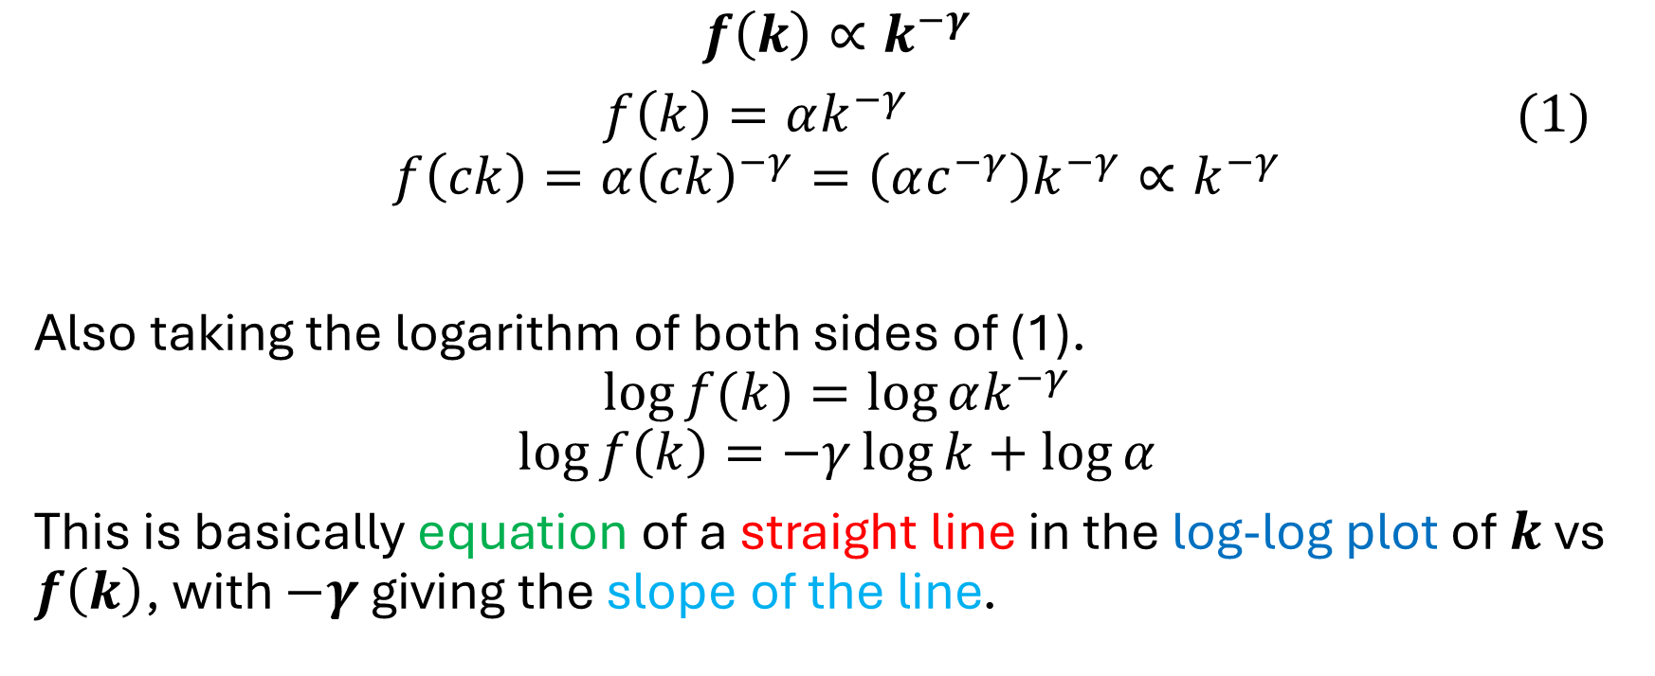
Why is this called scale-free?
$$f\left(k\right)∝k^{−γ}$$
$f\left(k\right)=αk^{−γ}\text{ (1) }$
$$f\left(ck\right)=α{\left(ck\right)}^{−γ}=\left(αc^{−γ}\right)k^{−γ}∝k^{−γ}$$
Also taking the logarithm of both sides of (1).
$$\log{f(k)}=\log{αk^{−γ}}$$
$$\log{f\left(k\right)}=−γ\log{k}+\log{α}$$
This is basically equation of a straight line in the log-log plot of $k$ vs $f\left(k\right)$, with $−γ$ giving the slope of the line.

Slide 14
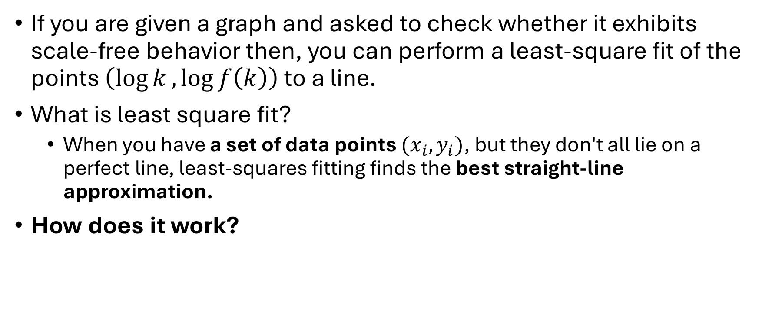
How to check whether a graph exhibits scale-free behavior?
If you are given a graph and asked to check whether it exhibits scale-free behavior then, you can perform a least-square fit of the points $\left(\log{k},\log{f\left(k\right)}\right)$ to a line.
What is least square fit?
When you have a set of data points $(x_{i}, y_{i})$, but they don't all lie on a perfect line, least-squares fitting finds the best straight-line approximation.
How does it work?

Slide 15
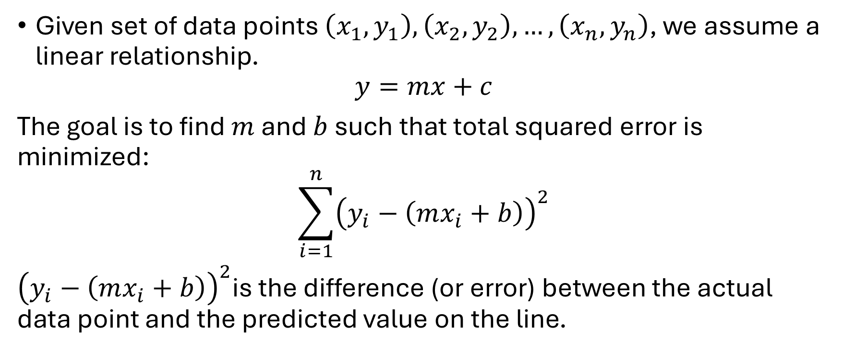
Least-square fit
Given set of data points $\left(x_{1},y_{1}\right), \left(x_{2},y_{2}\right), …, \left(x_{n}, y_{n}\right)$, we assume a linear relationship.
$$y=mx+c$$
The goal is to find $m$ and $b$ such that total squared error is minimized:
$$\sum_{i=1}^{n}{{\left(y_{i}−\left(mx_{i}+b\right)\right)}^{2}}$$
${\left(y_{i}−\left(mx_{i}+b\right)\right)}^{2}$is the difference (or error) between the actual data point and the predicted value on the line.

Slide 16
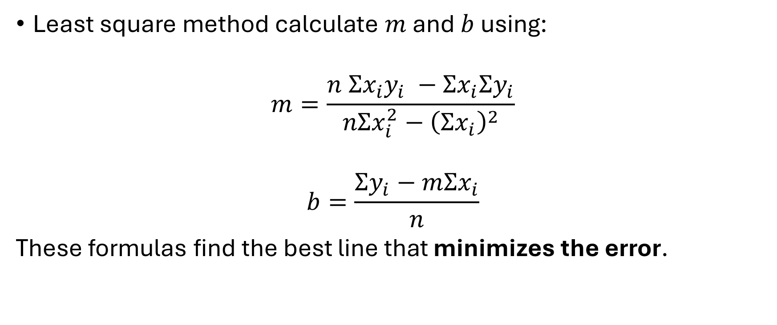
Least-square fit
Least square method calculate $m$ and $b$ using:
$$m=\frac{n Σx_{i}y_{i} −Σx_{i}Σy_{i}}{nΣx_{i}^{2}−{\left(Σx_{i}\right)}^{2}}$$
$$b=\frac{Σy_{i}−mΣx_{i}}{n}$$
These formulas find the best line that minimizes the error.

Slide 17
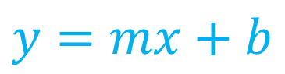
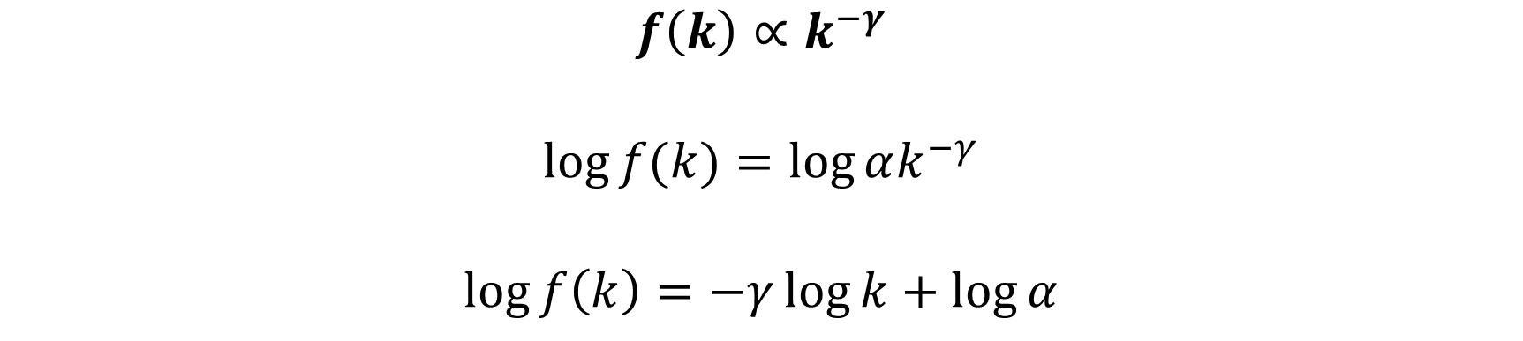
Determining whether a graph is scalar-free
$$f\left(k\right)∝k^{−γ}$$
$$\log{f(k)}=\log{αk^{−γ}}$$
$$\log{f\left(k\right)}=−γ\log{k}+\log{α}$$
Intercept
Slope
$$y=mx+b$$

Slide 18
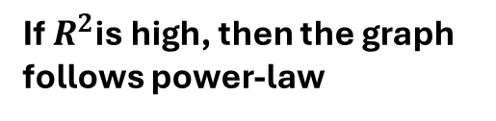
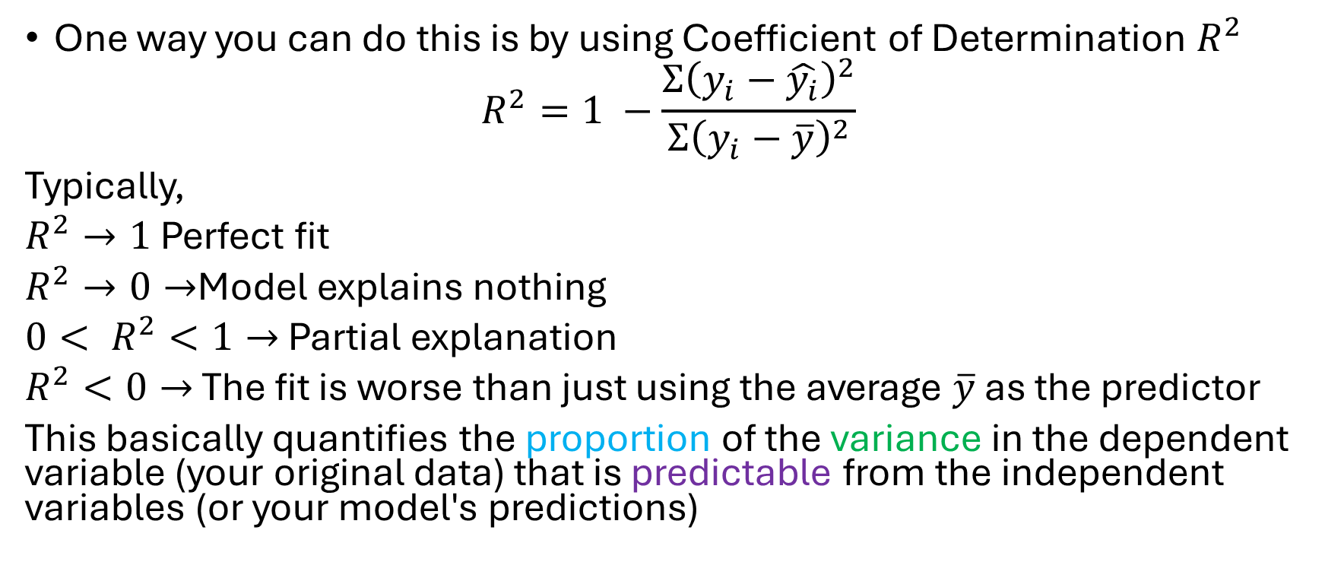
How to check whether how well this line fit?
One way you can do this is by using Coefficient of Determination $R^{2}$
$$R^{2}=1 −\frac{Σ{\left(y_{i}−\hat{y_{i}}\right)}^{2}}{Σ{\left(y_{i}−\overline{y}\right)}^{2}}$$
Typically,
$R^{2}→1$ Perfect fit
$R^{2}→0→$Model explains nothing
${0< R}^{2}<1→$ Partial explanation
$R^{2}<0→$ The fit is worse than just using the average $\overline{y}$ as the predictor
This basically quantifies the proportion of the variance in the dependent variable (your original data) that is predictable from the independent variables (or your model's predictions)
Variance
If $R^{2}$is high, then the graph follows power-law

Slide 19
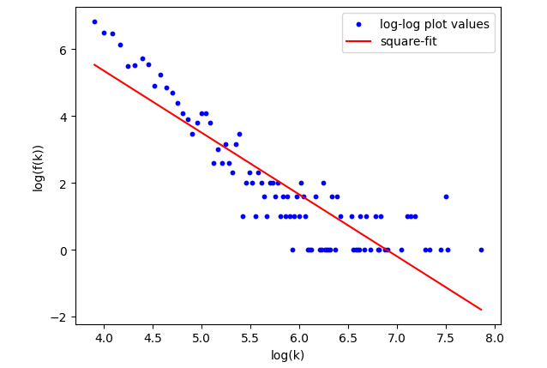

Slide 20
In class-exercise
Check whether the facebook_combined dataset is scale-free.
Load the dataset and follow what we did in the class.

Slide 21
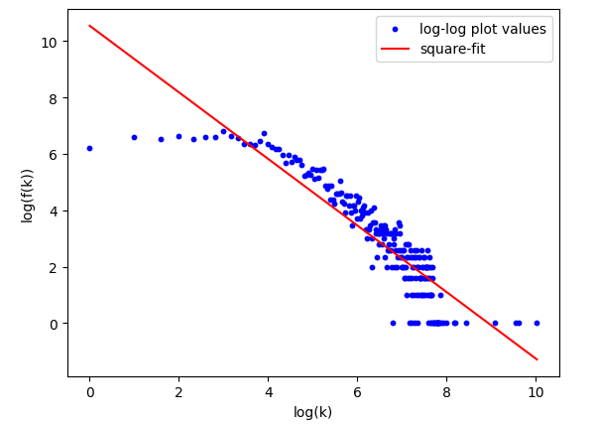
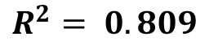
Example: Facebook_combined dataset
$$R^{2}= 0.809$$

Slide 22
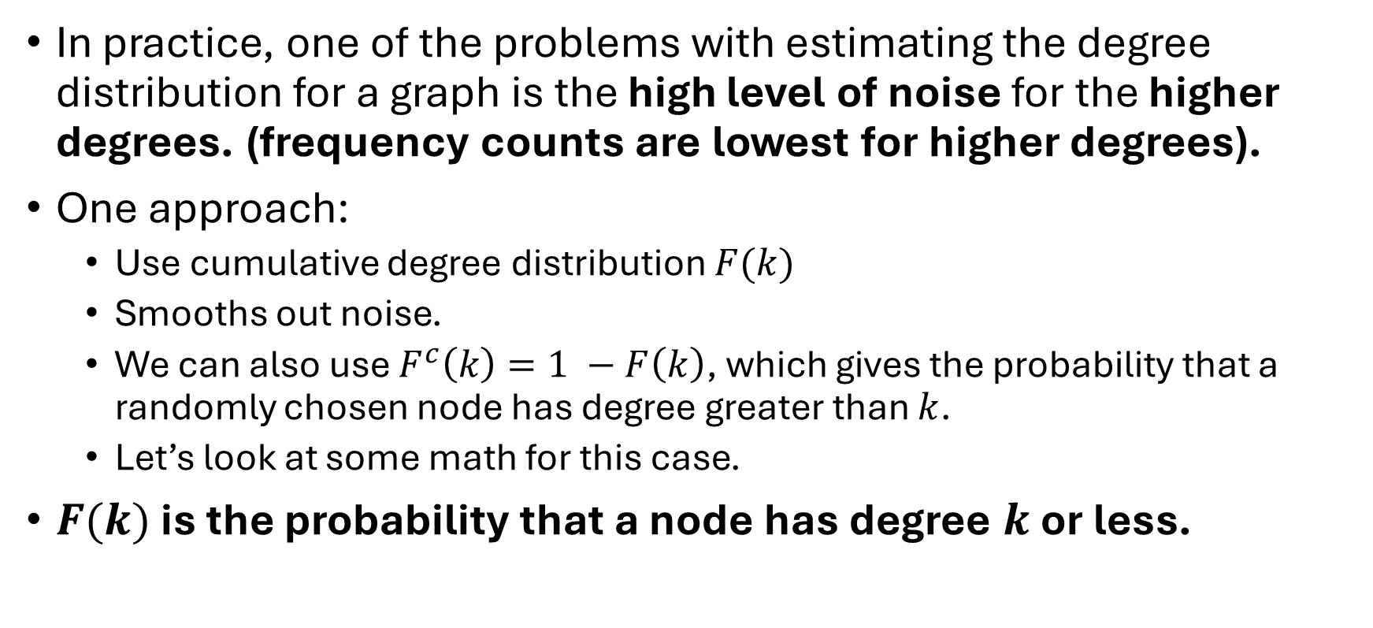
In practice, one of the problems with estimating the degree distribution for a graph is the high level of noise for the higher degrees. (frequency counts are lowest for higher degrees).
One approach:
Use cumulative degree distribution $F(k)$
Smooths out noise.
We can also use $F^{c}\left(k\right)=1 −F\left(k\right)$, which gives the probability that a randomly chosen node has degree greater than $k$.
Let’s look at some math for this case.
$F(k)$ is the probability that a node has degree $k$ or less.

Slide 23
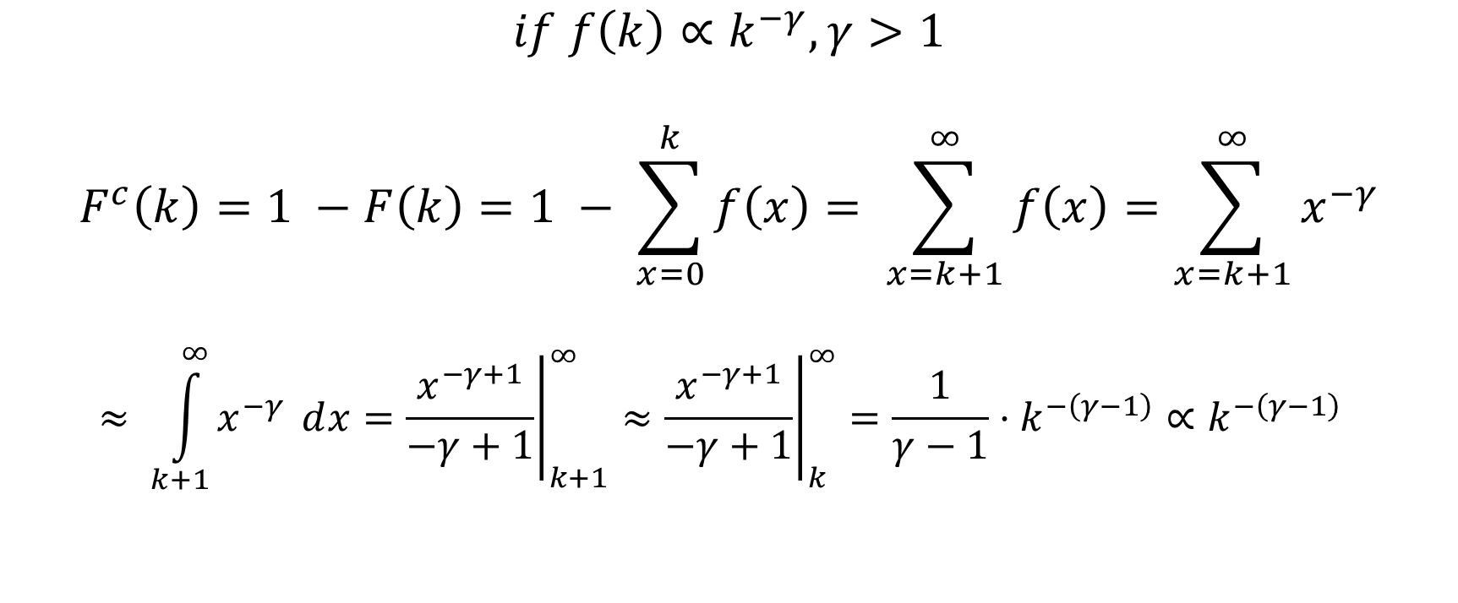
$$if f\left(k\right)∝k^{−γ}, γ>1$$
$$F^{c}\left(k\right)=1 −F\left(k\right)=1 − \sum_{x=0}^{k}{f\left(x\right)}= \sum_{x=k+1}^{∞}{f\left(x\right)}=\sum_{x=k+1}^{∞}{x^{−γ}}$$
$$≈ \int_{k+1}^{∞}{x^{−γ} ⅆx}={\left.\frac{x^{−γ+1}}{−γ+1}\right|}_{k+1}^{∞}≈{\left.\frac{x^{−γ+1}}{−γ+1}\right|}_{k}^{∞}=\frac{1}{γ−1}⋅k^{−\left(γ−1\right)}∝k^{−\left(γ−1\right)}$$
When k is large
In other words, log-log plot of $F^{c}\left(k\right) versus k$ will also be a power-law with slope $−\left(γ−1\right)$ as opposed to $−γ.$

Slide 24
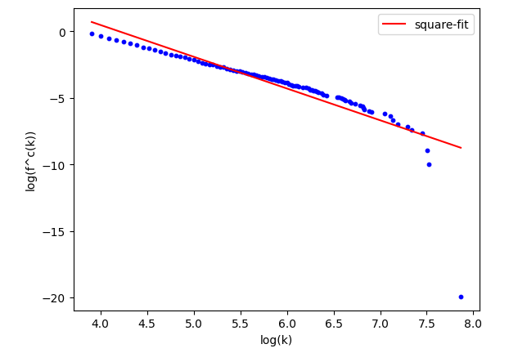

Slide 25
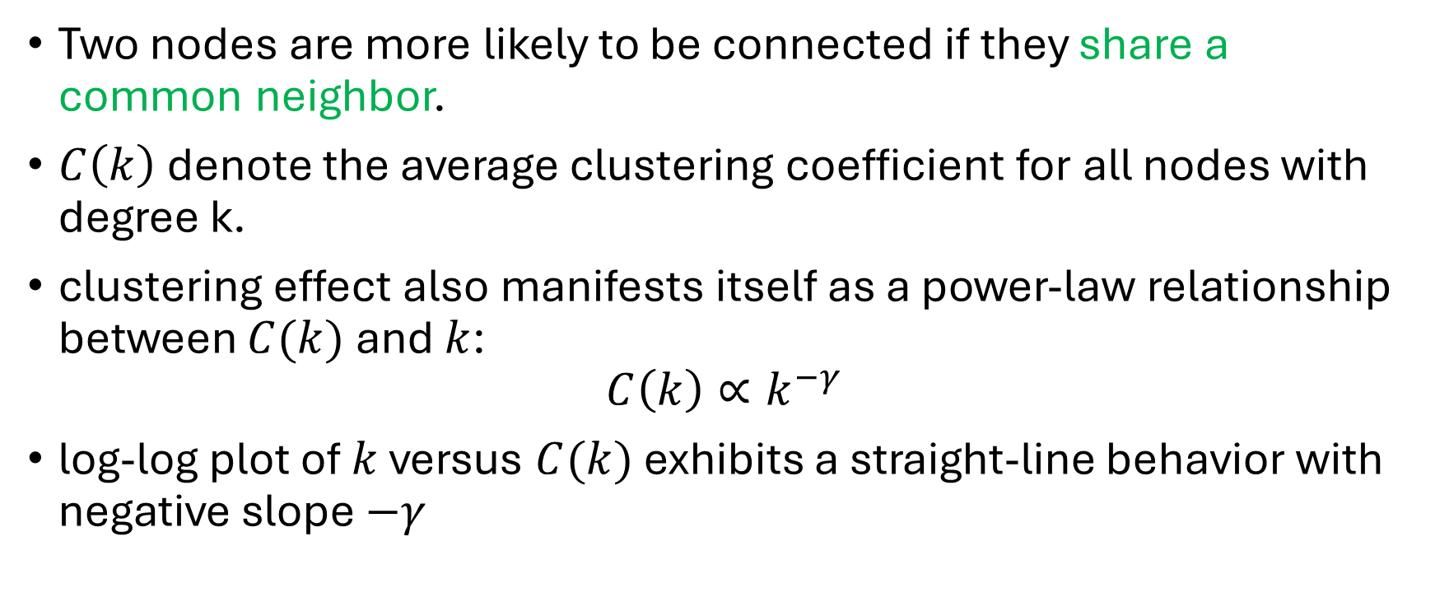
Clustering effect
Two nodes are more likely to be connected if they share a common neighbor.
$C\left(k\right)$ denote the average clustering coefficient for all nodes with degree k.
clustering effect also manifests itself as a power-law relationship between $C(k)$ and $k$:
$$C\left(k\right)∝k^{−γ}$$
log-log plot of $k$ versus $C(k)$ exhibits a straight-line behavior with negative slope $−γ$

Slide 26
Clustering effect; Why?
High-degree nodes (hubs) connect to many nodes, but their neighbors are often not connected to each other.
A hub connects to many low-degree nodes from different parts of the network.
These low-degree nodes are unlikely to be connected to each other.
Low-degree nodes are often in tightly connected local communities.
A low-degree node may connect to only a few nodes in a well-defined cluster.
These neighbors are more likely to be connected to each other, forming triangles.

Slide 27
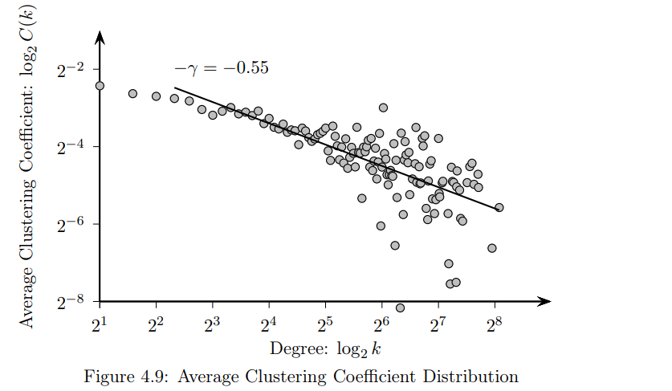

Slide 28
Why?
Nodes that are sparsely connected (i.e., have smaller degrees) are part of highly clustered areas (i.e., have higher average clustering coefficients).
Only a few hub nodes (with high degrees) connect these clustered areas (the hub nodes have smaller clustering coefficients).

Slide 29
Graph models
Now, we are going to look at different graph generation models.
Understanding different graph models is crucial because real-world networks (e.g., social networks, biological systems, and communication networks) exhibit diverse structural properties. Different models help us simulate, analyze, and predict behaviors in these networks.
We will learn about 3 models
Watts-Strogatz model.
Barabasi-Albert model.
Erdos-Renyi Random graph model.

Slide 30
Real-world networks have different structures
Different networks follow different connectivity patterns. By studying various models, we can match them to real-world networks:
Network type | Best model to use | Why?
Social Networks | Watts-Strogatz | Small-world property (short path lengths, high clustering)
Web networks/Internet | Barabasi-Albert (BA) | Scale-free properties (hubs, power-law degree distribution)
Scientific collaboration networks | Barabasi-Albert (BA) | A few researchers (hubs) have many collaborators
Road and Transportation Networks | Watts-Strogatz | Mostly local connections with some shortcuts
Neural networks | Watts-Stragatz | High clustering with short path lengths

Slide 31
Understanding How Networks Evolve
Different models explain how networks grow over time:
Barabási–Albert Model (Preferential Attachment):
Explains why some nodes (hubs) get disproportionately many connections.
Example: How popular websites (Google, Wikipedia) get more links over time.
Watts–Strogatz Model (Small-World Effect):
Explains why most real-world networks have short path lengths and high clustering.
Example: Why social networks allow people to connect in just a few steps (Six Degrees of Separation).
Erdős–Rényi Random Graph Model:
Useful for studying random connectivity patterns, such as random failures in communication networks.

Slide 32
Predicting Network behavior
Graph models help in predicting how networks respond to changes.
Robustness and Attack Resistance
Scale-free (BA) networks are robust against random failures but vulnerable to targeted attacks.
Random networks (Erdős–Rényi) fail gradually when removing nodes.
Helps in designing more resilient infrastructure (e.g., the internet, power grids).
Spread of Information/Disease:
In small-world networks (WS model), diseases or viral content spread quickly.
Understanding these dynamics helps in epidemiology and marketing strategies.

Slide 33
Predicting Network behavior
Community Detection & Clustering
Graph models help in understanding community structures, like groups in social networks.
Helpful in disaster response.
Identify most vulnerable communities in network.

Slide 34
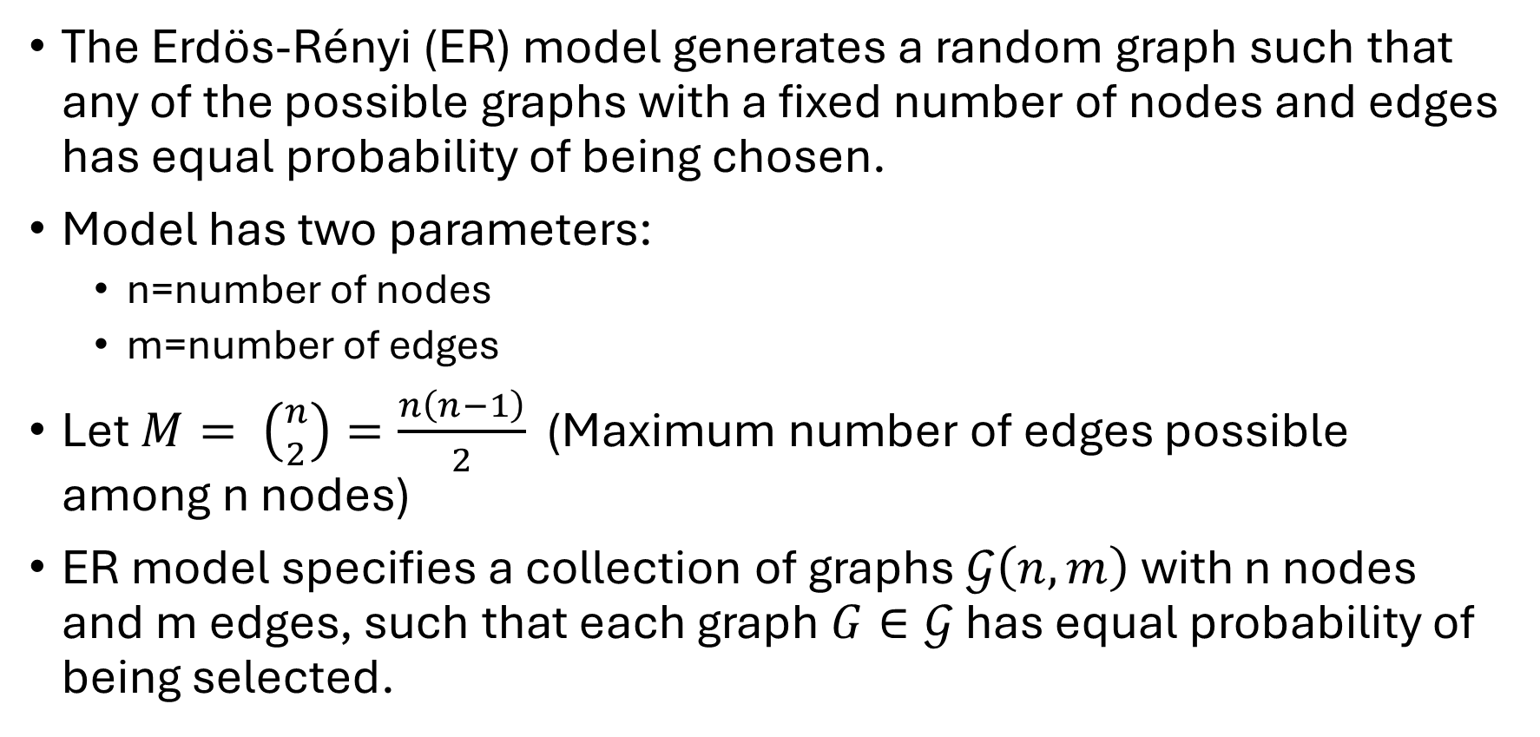
ERDÖS-RÉNYI RANDOM GRAPH
The Erdös-Rényi (ER) model generates a random graph such that any of the possible graphs with a fixed number of nodes and edges has equal probability of being chosen.
Model has two parameters:
n=number of nodes
m=number of edges
Let $M= \left({n \atop 2}\right)=\frac{n\left(n−1\right)}{2}$ (Maximum number of edges possible among n nodes)
ER model specifies a collection of graphs $𝒢\left(n,m\right)$ with n nodes and m edges, such that each graph $G∈𝒢$ has equal probability of being selected.

Slide 35
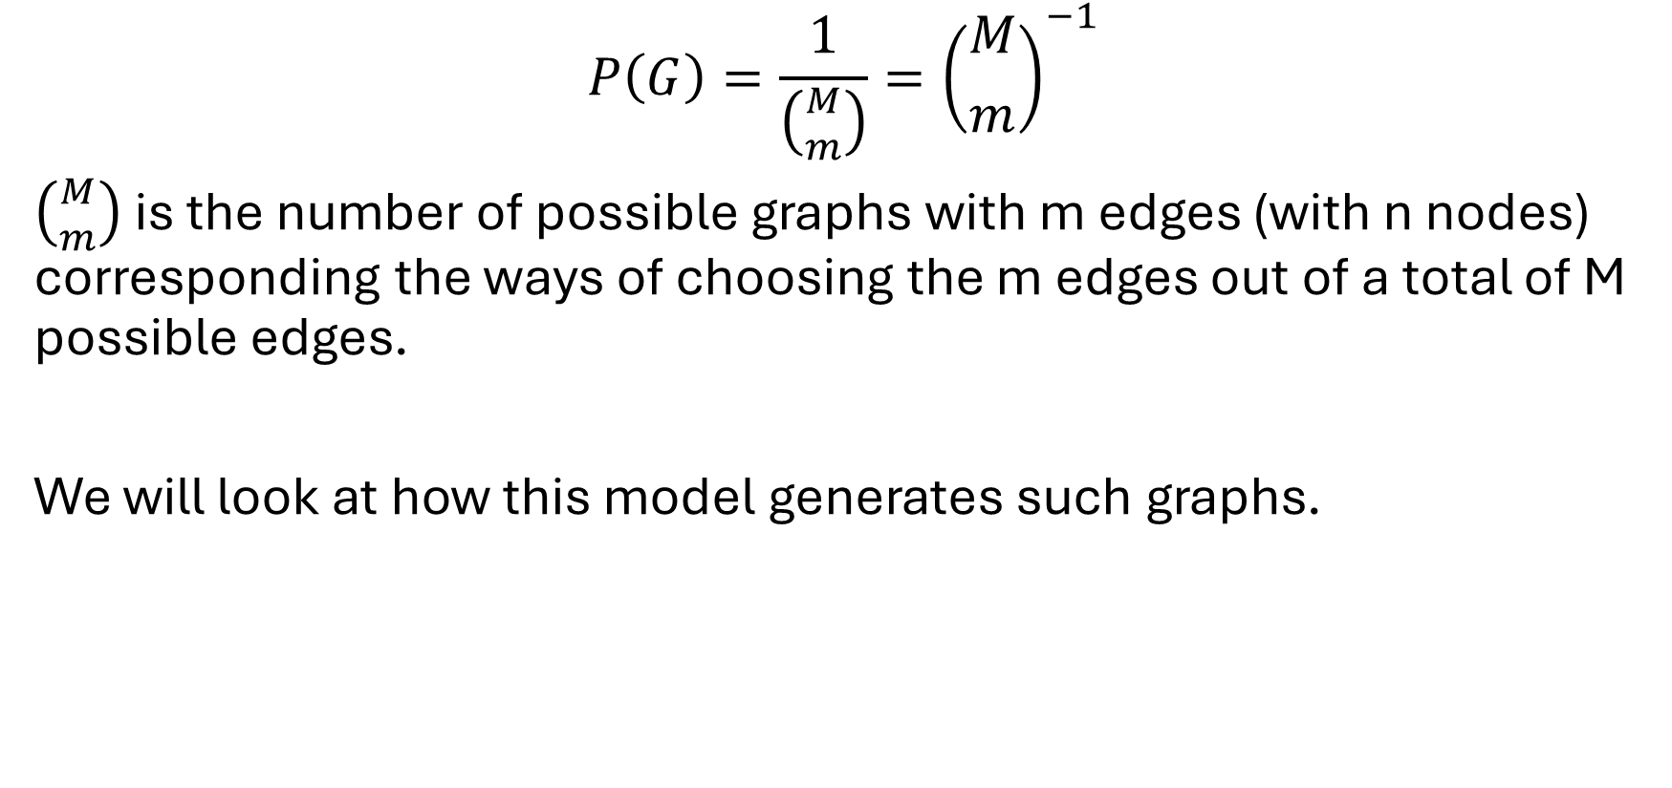
$$P\left(G\right)=\frac{1}{\left({M \atop m}\right)}={\left({M \atop m}\right)}^{−1}$$
$\left({M \atop m}\right)$ is the number of possible graphs with m edges (with n nodes) corresponding the ways of choosing the m edges out of a total of M possible edges.
We will look at how this model generates such graphs.

Slide 36
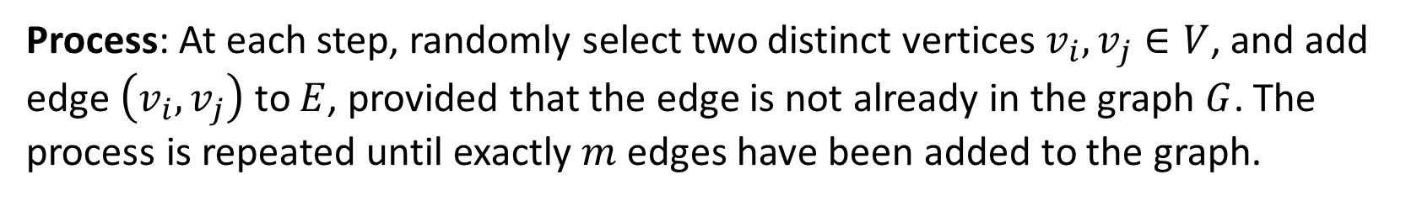
ERDÖS-RÉNYI RANDOM GRAPH generation
Process: At each step, randomly select two distinct vertices $v_{i}, v_{j}∈V$, and add edge $\left(v_{i}, v_{j}\right)$ to $E$, provided that the edge is not already in the graph $G$. The process is repeated until exactly $m$ edges have been added to the graph.

Slide 37
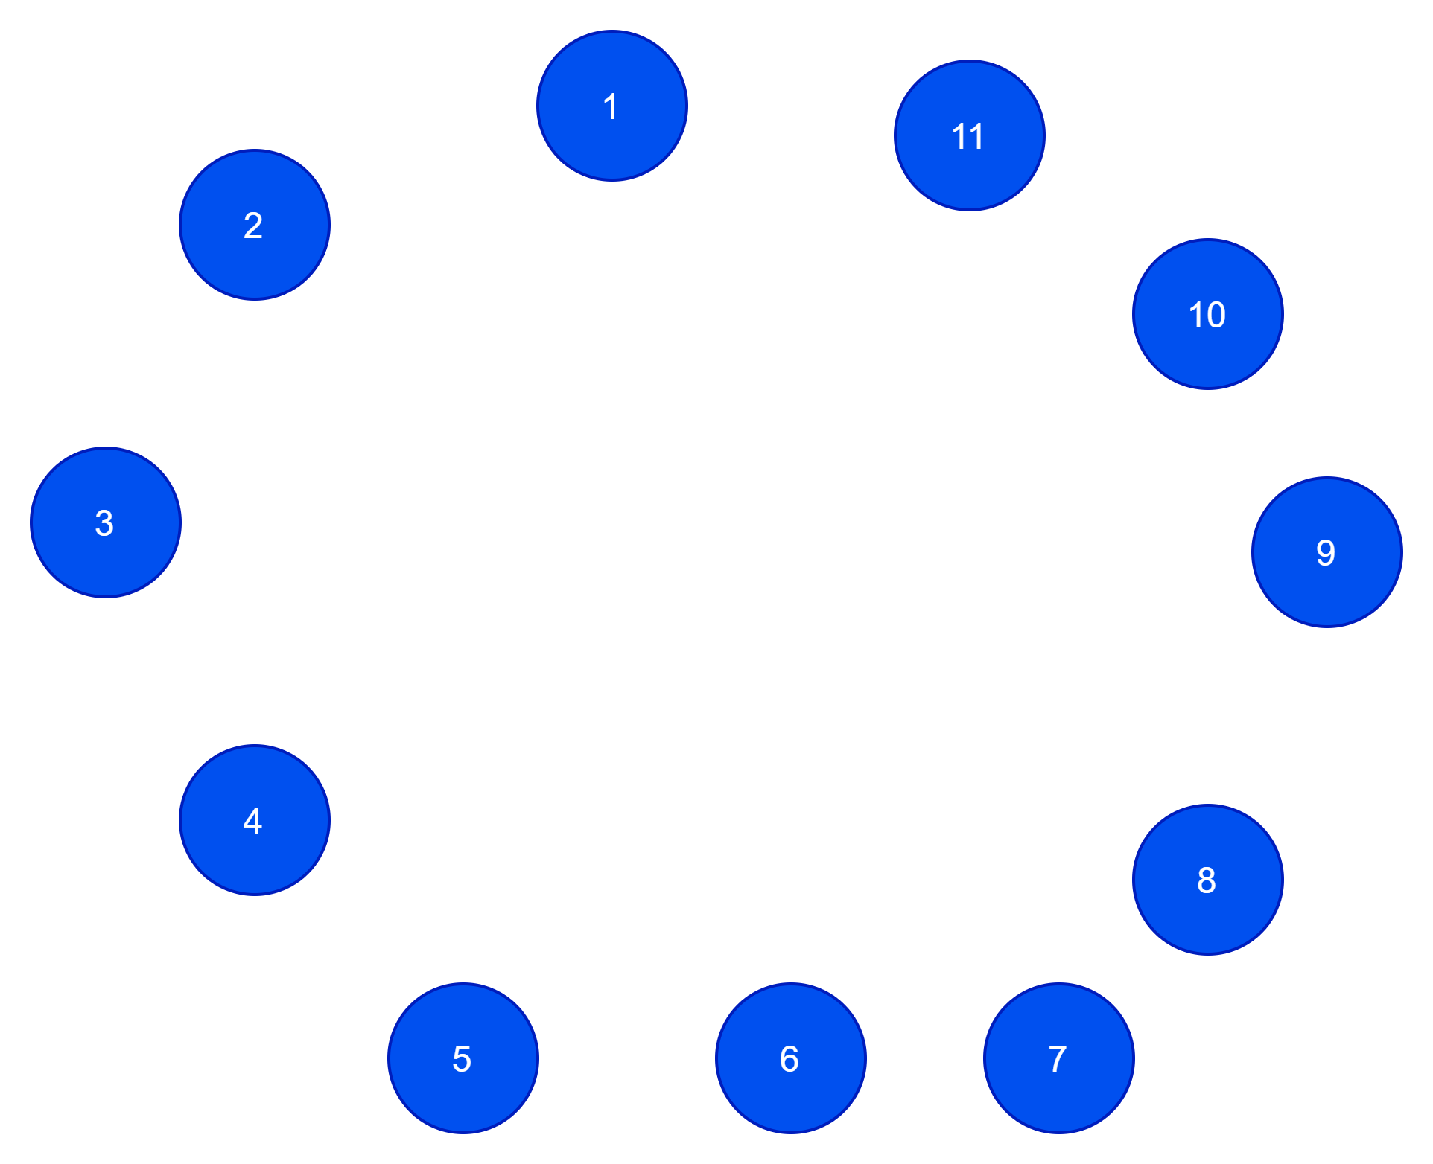
ERDÖS-RÉNYI RANDOM GRAPH generation
Parameters: n = 11, m = 15
Select a pair of nodes uniformly at random.
If an edge does not exist between the pair, add it.

Slide 38
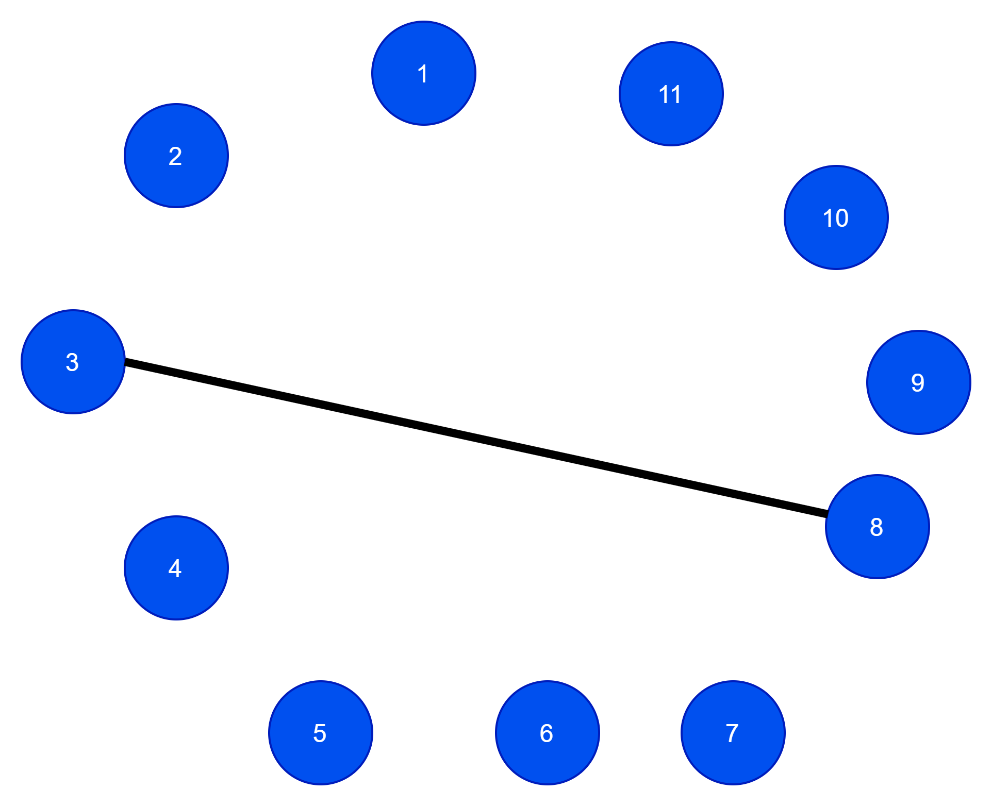
ERDÖS-RÉNYI RANDOM GRAPH generation
Parameters: n = 11, m = 15
Select a pair of nodes uniformly at random. (3, 8)
If an edge does not exist between the pair, add it.

Slide 39
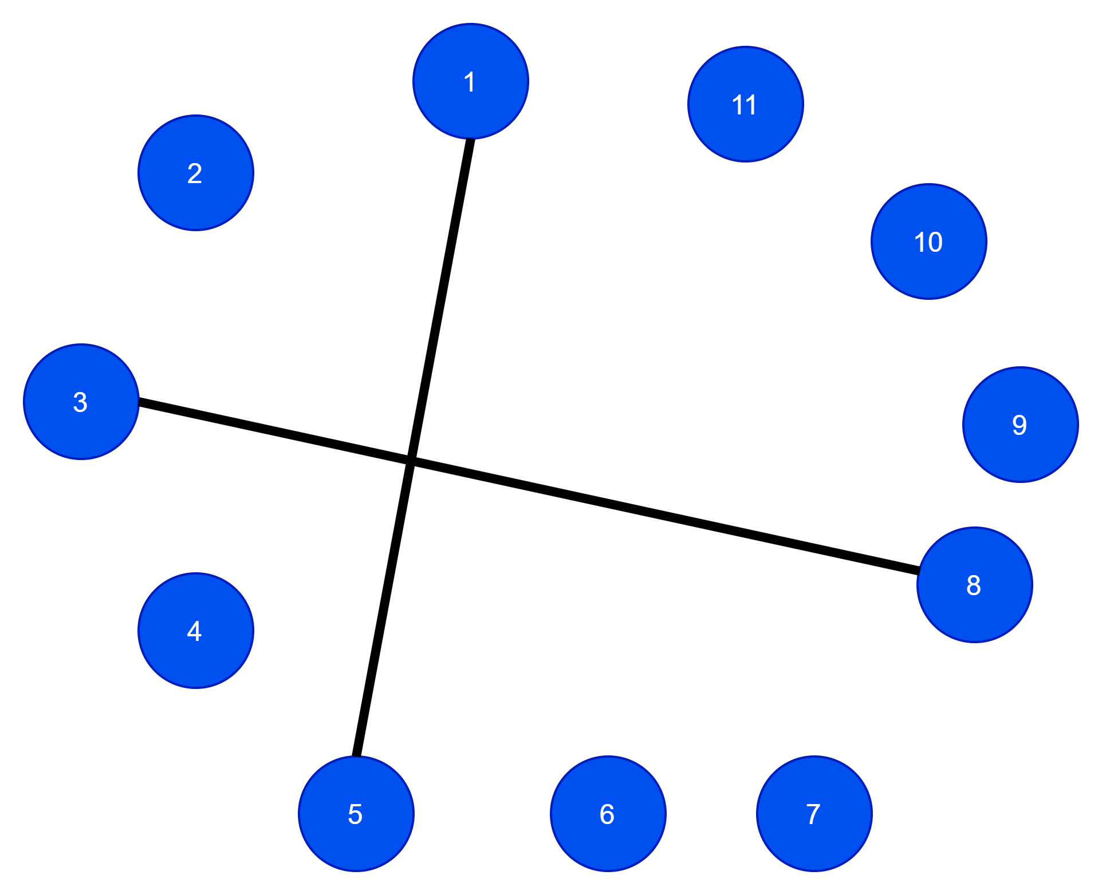
ERDÖS-RÉNYI RANDOM GRAPH generation
Parameters: n = 11, m = 15
Select a pair of nodes uniformly at random. (1, 5)
If an edge does not exist between the pair, add it.

Slide 40
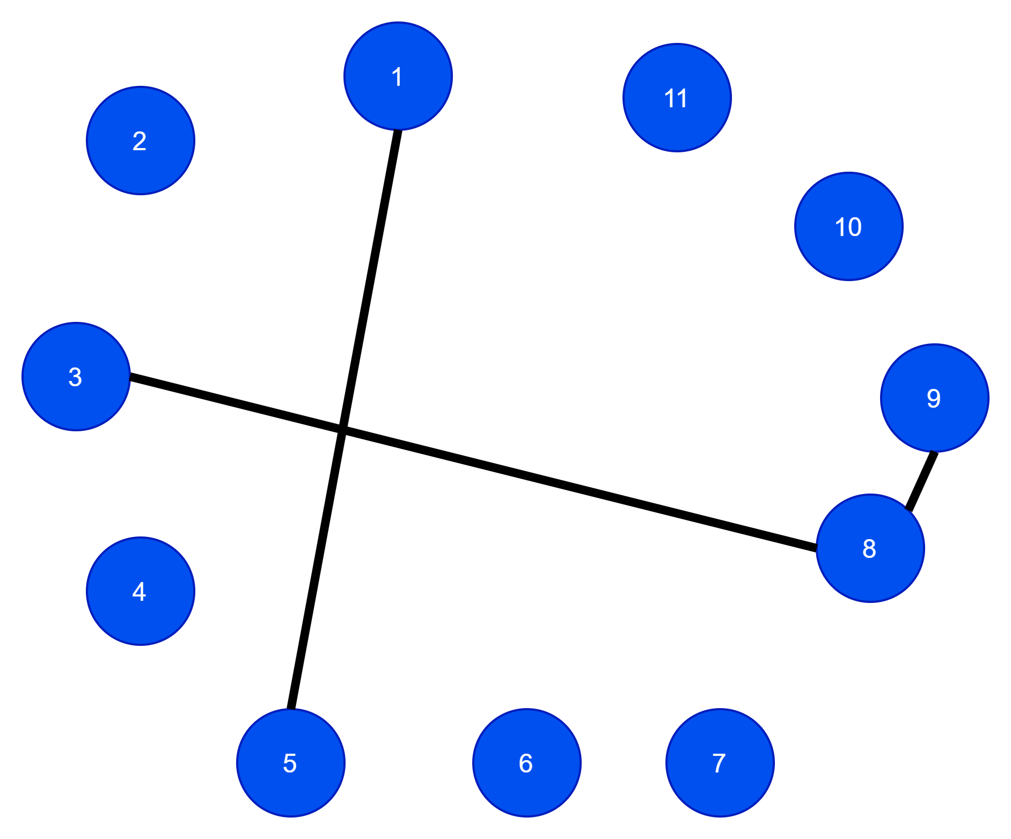
ERDÖS-RÉNYI RANDOM GRAPH generation
Parameters: n = 11, m = 15
Select a pair of nodes uniformly at random. (8,9)
If an edge does not exist between the pair, add it.

Slide 41
ERDÖS-RÉNYI RANDOM GRAPH generation
Parameters: n = 11, m = 15
Select a pair of nodes uniformly at random. (1,5)
If an edge does not exist between the pair, add it.
We skip it as the edge exists in the graph.

Slide 42

ERDÖS-RÉNYI RANDOM GRAPH generation
Parameters: n = 11, m = 15
Select a pair of nodes uniformly at random. (6,7)
If an edge does not exist between the pair, add it.

Slide 43
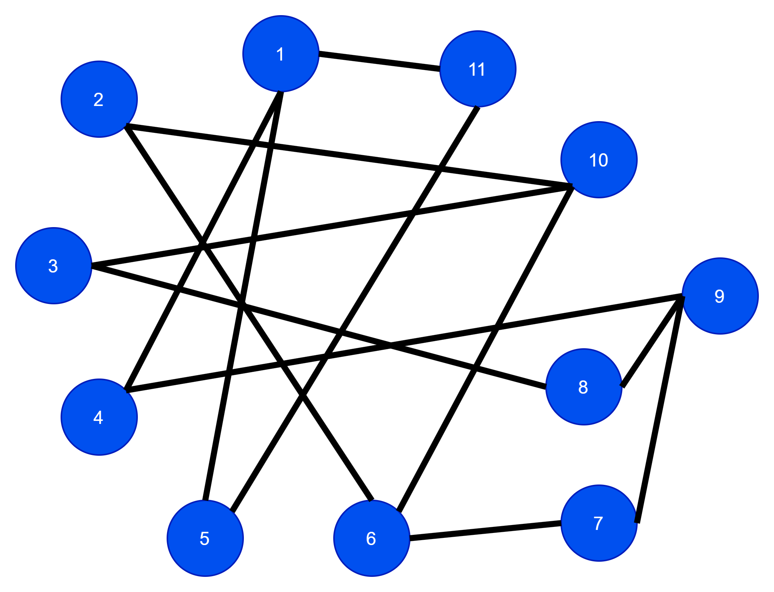
ERDÖS-RÉNYI RANDOM GRAPH generation
Parameters: n = 11, m = 15
Select a pair of nodes uniformly at random.
If an edge does not exist between the pair, add it.
Do this until m edges exist in the graph.

Slide 44
ERDÖS-RÉNYI GRAPH properties
Small-world behavior
Poisson degree distribution (not-power law).
No clustering effect.

Slide 45
BARABÁSI–ALBERT SCALE-FREE MODEL
The Barabási-Albert (BA) model tries to capture the scale-free degree distributions of real-world graphs via a generative process that adds new nodes and edges at each time step.
The edge growth is based on the concept of preferential attachment
Edges from the new vertex are more likely to link to nodes with higher degrees.
For this reason, this model is also known as rich get richer approach.

Slide 46
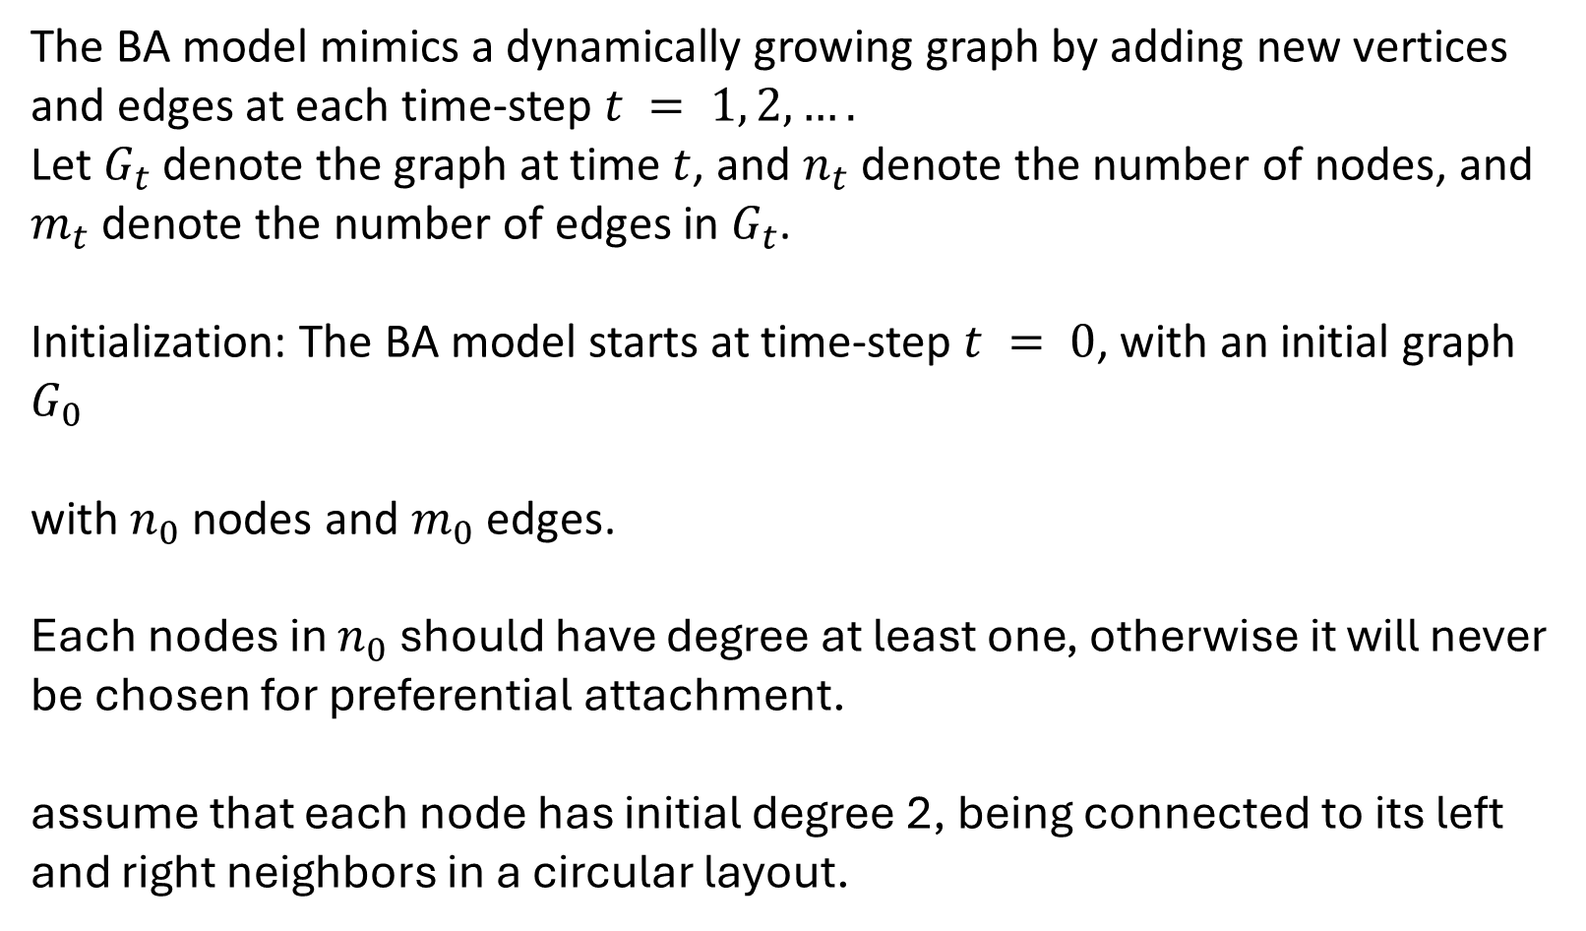
BARABÁSI–ALBERT GRAPH generation
The BA model mimics a dynamically growing graph by adding new vertices and edges at each time-step $t = 1, 2, ….$
Let $G_{t}$ denote the graph at time $t$, and $n_{t}$ denote the number of nodes, and $m_{t}$ denote the number of edges in $G_{t}$.
Initialization: The BA model starts at time-step $t = 0$, with an initial graph $G_{0}$
with $n_{0}$ nodes and $m_{0}$ edges.
Each nodes in $n_{0}$ should have degree at least one, otherwise it will never be chosen for preferential attachment.
assume that each node has initial degree 2, being connected to its left and right neighbors in a circular layout.
Notes:
Pronunciation: Barabashi albert

Slide 47
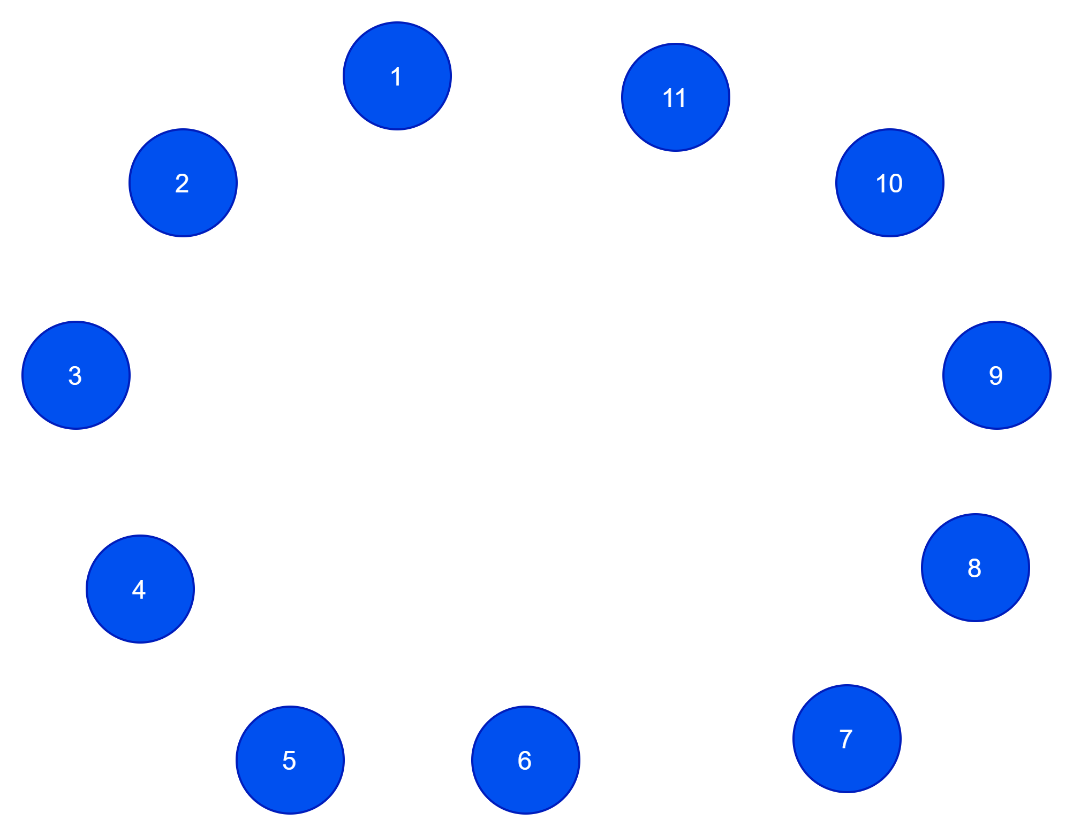
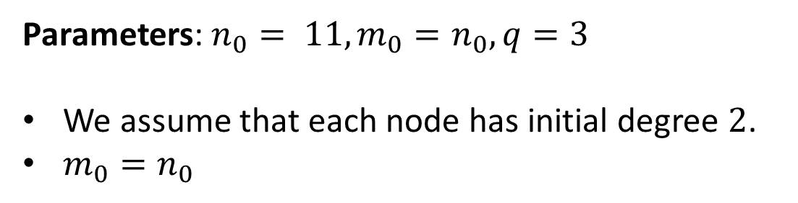
BARABÁSI–ALBERT GRAPH generation
The BA model mimics a dynamically growing graph by adding new vertices
Parameters: $n_{0}= 11, m_{0}=n_{0}, q=3$
We assume that each node has initial degree $2$.
$m_{0}=n_{0}$

Slide 48
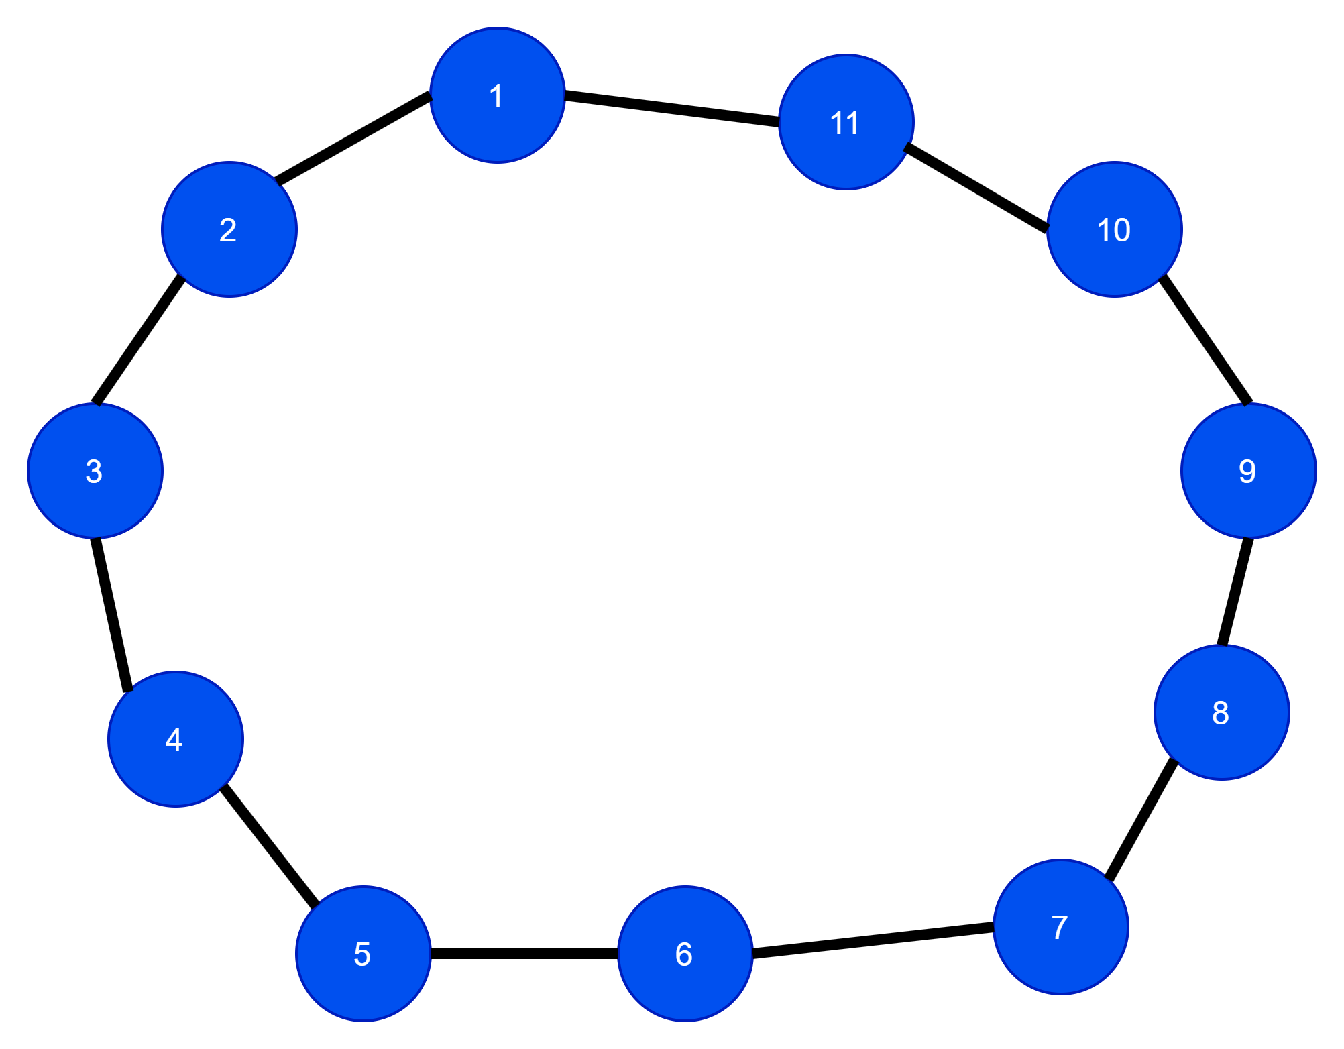
BARABÁSI–ALBERT GRAPH generation
The BA model mimics a dynamically growing graph by adding new vertices
Parameters: $n_{0}= 11, m_{0}=n_{0}, q=3$
We assume that each node has initial degree $2$.
$m_{0}=n_{0}$

Slide 49
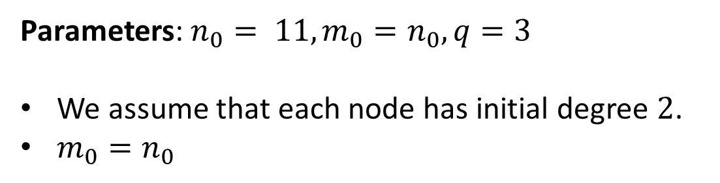
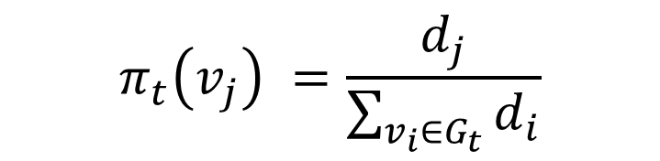
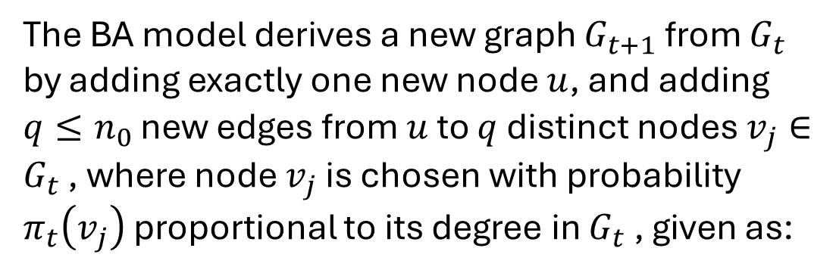
BARABÁSI–ALBERT GRAPH generation
The BA model mimics a dynamically growing graph by adding new vertices
Parameters: $n_{0}= 11, m_{0}=n_{0}, q=3$
We assume that each node has initial degree $2$.
$m_{0}=n_{0}$
The BA model derives a new graph $G_{t+1}$ from $G_{t}$ by adding exactly one new node $u$, and adding $q≤n_{0}$ new edges from $u$ to $q$ distinct nodes $v_{j}∈G_{t}$ , where node $v_{j}$ is chosen with probability $π_{t}\left(v_{j}\right)$ proportional to its degree in $G_{t}$ , given as:
$$π_{t}\left(v_{j}\right) =\frac{d_{j}}{\sum_{v_{i}∈G_{t}}{d_{i}}}$$

Slide 50
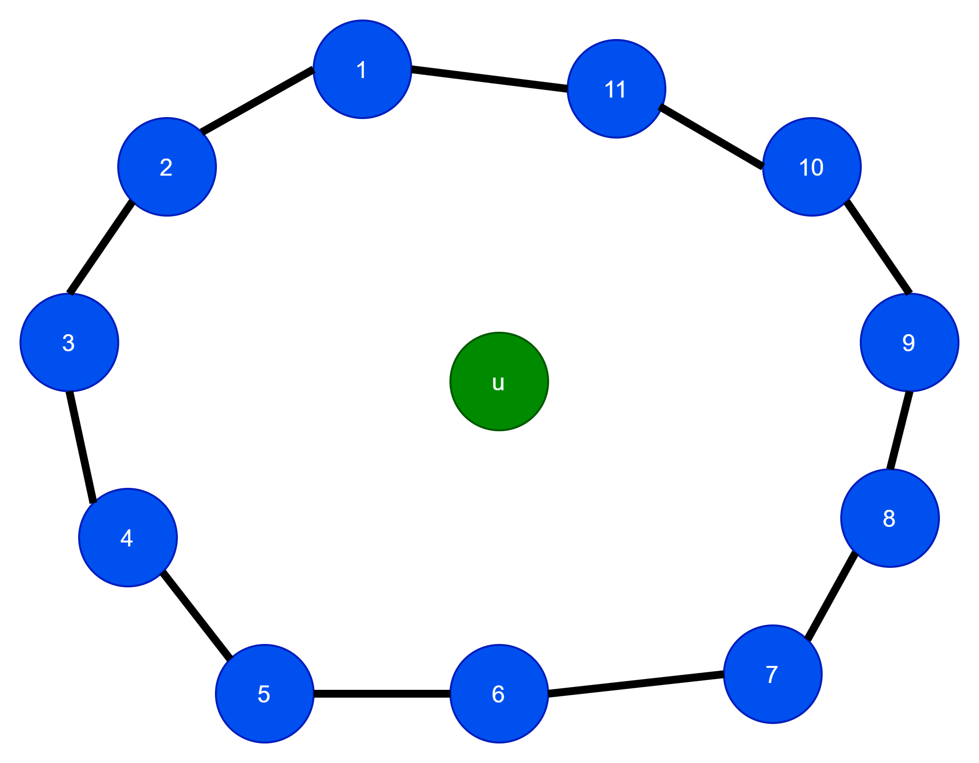
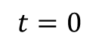
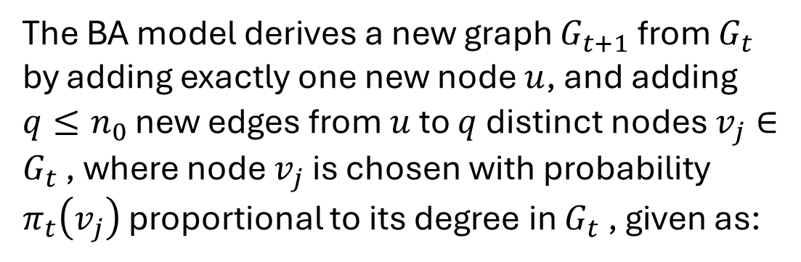
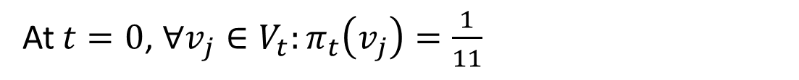
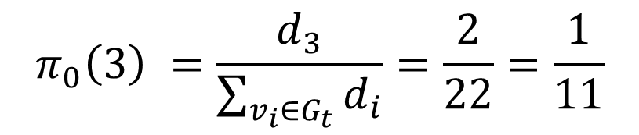
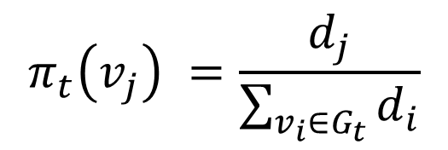
BARABÁSI–ALBERT GRAPH generation
The BA model mimics a dynamically growing graph by adding new vertices
Parameters: $n_{0}= 11, m_{0}=n_{0}, q=3$
The BA model derives a new graph $G_{t+1}$ from $G_{t}$ by adding exactly one new node $u$, and adding $q≤n_{0}$ new edges from $u$ to $q$ distinct nodes $v_{j}∈G_{t}$ , where node $v_{j}$ is chosen with probability $π_{t}\left(v_{j}\right)$ proportional to its degree in $G_{t}$ , given as:
$$t=0$$
$$π_{t}\left(v_{j}\right) =\frac{d_{j}}{\sum_{v_{i}∈G_{t}}{d_{i}}}$$
$$π_{0}\left(3\right) =\frac{d_{3}}{\sum_{v_{i}∈G_{t}}{d_{i}}}=\frac{2}{22}=\frac{1}{11}$$
At $t=0$, $∀v_{j}∈V_{t}:π_{t}\left(v_{j}\right)=\frac{1}{11}$

Slide 51
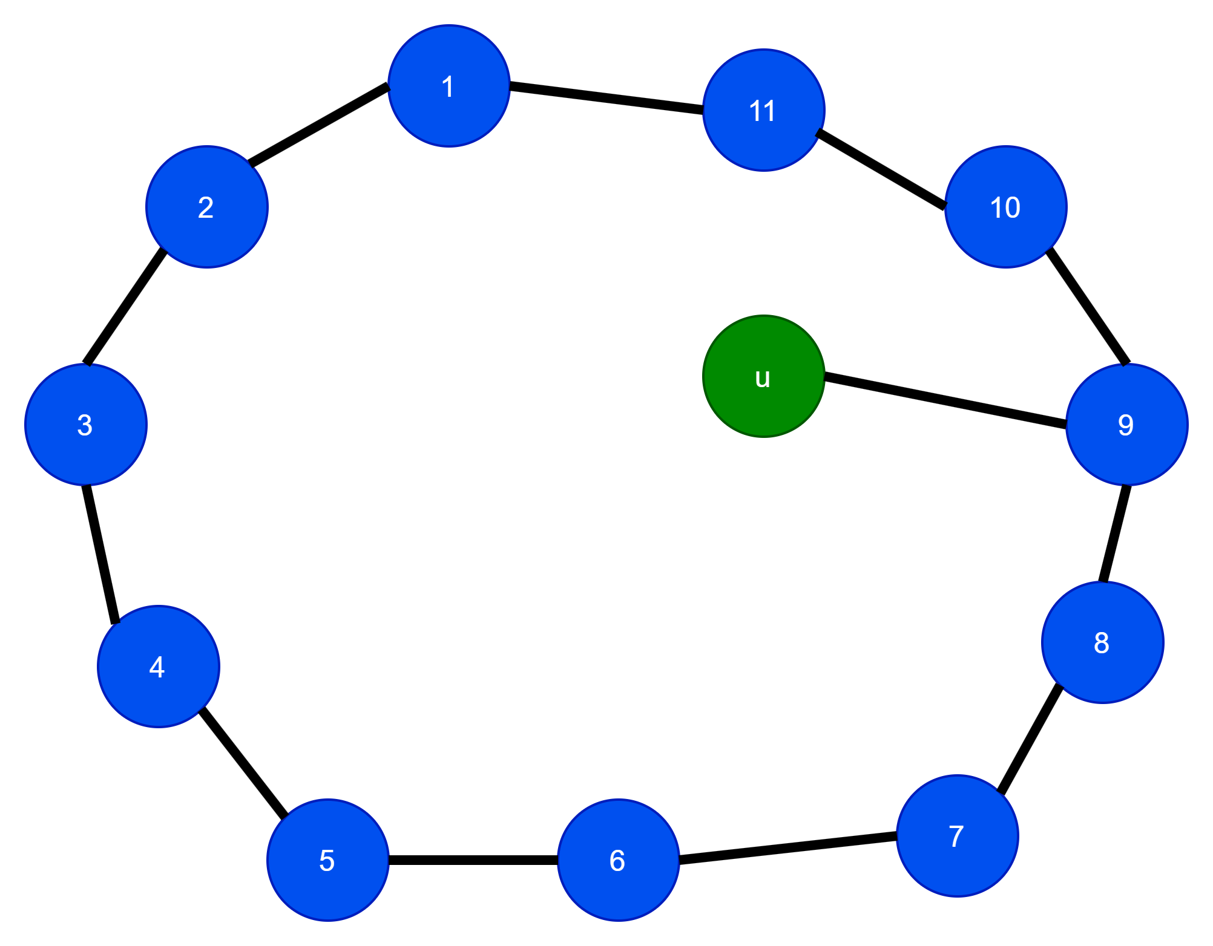
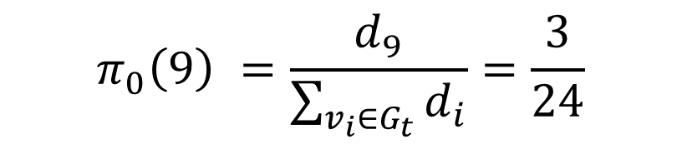

BARABÁSI–ALBERT GRAPH generation
The BA model mimics a dynamically growing graph by adding new vertices
Parameters: $n_{0}= 11, m_{0}=n_{0}, q=3$
The BA model derives a new graph $G_{t+1}$ from $G_{t}$ by adding exactly one new node $u$, and adding $q≤n_{0}$ new edges from $u$ to $q$ distinct nodes $v_{j}∈G_{t}$ , where node $v_{j}$ is chosen with probability $π_{t}\left(v_{j}\right)$ proportional to its degree in $G_{t}$ , given as:
$$t=0$$
$$π_{t}\left(v_{j}\right) =\frac{d_{j}}{\sum_{v_{i}∈G_{t}}{d_{i}}}$$
$$π_{0}\left(3\right) =\frac{d_{3}}{\sum_{v_{i}∈G_{t}}{d_{i}}}=\frac{2}{24}$$
$$π_{0}\left(9\right) =\frac{d_{9}}{\sum_{v_{i}∈G_{t}}{d_{i}}}=\frac{3}{24}$$

Slide 52



BARABÁSI–ALBERT GRAPH generation
The BA model mimics a dynamically growing graph by adding new vertices
Parameters: $n_{0}= 11, m_{0}=n_{0}, q=3$
The BA model derives a new graph $G_{t+1}$ from $G_{t}$ by adding exactly one new node $u$, and adding $q≤n_{0}$ new edges from $u$ to $q$ distinct nodes $v_{j}∈G_{t}$ , where node $v_{j}$ is chosen with probability $π_{t}\left(v_{j}\right)$ proportional to its degree in $G_{t}$ , given as:
$$t=0$$
$$π_{t}\left(v_{j}\right) =\frac{d_{j}}{\sum_{v_{i}∈G_{t}}{d_{i}}}$$
$$π_{0}\left(3\right) =\frac{d_{3}}{\sum_{v_{i}∈G_{t}}{d_{i}}}=\frac{2}{26}$$
$$π_{0}\left(9\right)=π_{0}\left(1\right)=\frac{3}{26}$$

Slide 53



BARABÁSI–ALBERT GRAPH generation
The BA model mimics a dynamically growing graph by adding new vertices
Parameters: $n_{0}= 11, m_{0}=n_{0}, q=3$
The BA model derives a new graph $G_{t+1}$ from $G_{t}$ by adding exactly one new node $u$, and adding $q≤n_{0}$ new edges from $u$ to $q$ distinct nodes $v_{j}∈G_{t}$ , where node $v_{j}$ is chosen with probability $π_{t}\left(v_{j}\right)$ proportional to its degree in $G_{t}$ , given as:
$$t=0$$
$$π_{t}\left(v_{j}\right) =\frac{d_{j}}{\sum_{v_{i}∈G_{t}}{d_{i}}}$$
$$π_{0}\left(3\right) =\frac{d_{3}}{\sum_{v_{i}∈G_{t}}{d_{i}}}=\frac{2}{28}$$
$$π_{0}\left(9\right)=π_{0}\left(1\right)=π_{0}\left(6\right)=\frac{3}{28}$$

Slide 54





BARABÁSI–ALBERT GRAPH generation
$$π_{t}\left(v_{j}\right) =\frac{d_{j}}{\sum_{v_{i}∈G_{t}}{d_{i}}}$$
Parameters: $n_{0}= 11, m_{0}=n_{0}, q=3$
The BA model derives a new graph $G_{t+1}$ from $G_{t}$ by adding exactly one new node $u$, and adding $q≤n_{0}$ new edges from $u$ to $q$ distinct nodes $v_{j}∈G_{t}$ , where node $v_{j}$ is chosen with probability $π_{t}\left(v_{j}\right)$ proportional to its degree in $G_{t}$ , given as:
$$t=1$$
$$\sum_{v_{i}∈G_{t}}{d_{i}} ???$$

Slide 55



BARABÁSI–ALBERT GRAPH generation
$$π_{t}\left(v_{j}\right) =\frac{d_{j}}{\sum_{v_{i}∈G_{t}}{d_{i}}}$$
Parameters: $n_{0}= 11, m_{0}=n_{0}, q=3$
The BA model derives a new graph $G_{t+1}$ from $G_{t}$ by adding exactly one new node $u$, and adding $q≤n_{0}$ new edges from $u$ to $q$ distinct nodes $v_{j}∈G_{t}$ , where node $v_{j}$ is chosen with probability $π_{t}\left(v_{j}\right)$ proportional to its degree in $G_{t}$ , given as:
$$t=1$$
$$\sum_{v_{i}∈G_{t}}{d_{i}}=28$$
$π_{1}\left(1\right), π_{1}\left(2\right),π_{1}\left(3\right)$, $π_{1}\left(4\right)$, $π_{1}\left(5\right),…,π_{1}\left(12\right)?$

Slide 56


BARABÁSI–ALBERT GRAPH generation
$$π_{t}\left(v_{j}\right) =\frac{d_{j}}{\sum_{v_{i}∈G_{t}}{d_{i}}}$$
Parameters: $n_{0}= 11, m_{0}=n_{0}, q=3$
The BA model derives a new graph $G_{t+1}$ from $G_{t}$ by adding exactly one new node $u$, and adding $q≤n_{0}$ new edges from $u$ to $q$ distinct nodes $v_{j}∈G_{t}$ , where node $v_{j}$ is chosen with probability $π_{t}\left(v_{j}\right)$ proportional to its degree in $G_{t}$ , given as:
$$t=1$$
$$\sum_{v_{i}∈G_{t}}{d_{i}}=28$$
$π_{1}\left(1\right), π_{1}\left(2\right),π_{1}\left(3\right)$, $π_{1}\left(4\right)$, $π_{1}\left(5\right),…,π_{1}\left(12\right)?$
$$π_{1}\left(2\right)??$$

Slide 57


BARABÁSI–ALBERT GRAPH generation
$$π_{t}\left(v_{j}\right) =\frac{d_{j}}{\sum_{v_{i}∈G_{t}}{d_{i}}}$$
Parameters: $n_{0}= 11, m_{0}=n_{0}, q=3$
The BA model derives a new graph $G_{t+1}$ from $G_{t}$ by adding exactly one new node $u$, and adding $q≤n_{0}$ new edges from $u$ to $q$ distinct nodes $v_{j}∈G_{t}$ , where node $v_{j}$ is chosen with probability $π_{t}\left(v_{j}\right)$ proportional to its degree in $G_{t}$ , given as:
$$t=1$$
$$\sum_{v_{i}∈G_{t}}{d_{i}}=28$$
$π_{1}\left(1\right), π_{1}\left(2\right),π_{1}\left(3\right)$, $π_{1}\left(4\right)$, $π_{1}\left(5\right),…,π_{1}\left(12\right)?$
$$π_{1}\left(2\right)=\frac{d_{2}}{\sum_{v_{i}∈G_{t}}{d_{i}}}=\frac{2}{28}$$

Slide 58



BARABÁSI–ALBERT GRAPH generation
$$π_{t}\left(v_{j}\right) =\frac{d_{j}}{\sum_{v_{i}∈G_{t}}{d_{i}}}$$
Parameters: $n_{0}= 11, m_{0}=n_{0}, q=3$
The BA model derives a new graph $G_{t+1}$ from $G_{t}$ by adding exactly one new node $u$, and adding $q≤n_{0}$ new edges from $u$ to $q$ distinct nodes $v_{j}∈G_{t}$ , where node $v_{j}$ is chosen with probability $π_{t}\left(v_{j}\right)$ proportional to its degree in $G_{t}$ , given as:
$$t=1$$
$$\sum_{v_{i}∈G_{t}}{d_{i}}=28$$
$π_{1}\left(1\right), π_{1}\left(2\right),π_{1}\left(3\right)$, $π_{1}\left(4\right)$, $π_{1}\left(5\right),…,π_{1}\left(12\right)?$
$$π_{1}\left(2\right)=\frac{1}{14}$$
$$π_{1}\left(3\right)=\frac{d_{3}}{\sum_{v_{i}∈G_{t}}{d_{i}}}=\frac{2}{28}$$

Slide 59






BARABÁSI–ALBERT GRAPH generation
$$π_{t}\left(v_{j}\right) =\frac{d_{j}}{\sum_{v_{i}∈G_{t}}{d_{i}}}$$
Parameters: $n_{0}= 11, m_{0}=n_{0}, q=3$
The BA model derives a new graph $G_{t+1}$ from $G_{t}$ by adding exactly one new node $u$, and adding $q≤n_{0}$ new edges from $u$ to $q$ distinct nodes $v_{j}∈G_{t}$ , where node $v_{j}$ is chosen with probability $π_{t}\left(v_{j}\right)$ proportional to its degree in $G_{t}$ , given as:
$$t=1$$
$$\sum_{v_{i}∈G_{t}}{d_{i}}=28$$
$π_{1}\left(1\right), π_{1}\left(2\right),π_{1}\left(3\right)$, $π_{1}\left(4\right)$, $π_{1}\left(5\right),…,π_{1}\left(12\right)?$
$$π_{1}\left(2\right)=\frac{1}{14}$$
$$π_{1}\left(3\right)=\frac{2}{28}$$
$$π_{1}\left(12\right)=\frac{3}{28}$$
$$π_{1}\left(6\right)=\frac{3}{28}$$
All the other nodes have $\frac{1}{14}$ chance to get picked
$$π_{1}\left(12\right)=π_{1}\left(1\right)=π_{1}\left(9\right)=π_{1}\left(6\right)=\frac{3}{28}$$
Notes:
https://web.archive.org/web/20150824235818/http://www3.nd.edu/~networks/Publication%20Categories/03%20Journal%20Articles/Physics/StatisticalMechanics_Rev%20of%20Modern%20Physics%2074,%2047%20(2002).pdf

Slide 60






BARABÁSI–ALBERT GRAPH generation
$$π_{t}\left(v_{j}\right) =\frac{d_{j}}{\sum_{v_{i}∈G_{t}}{d_{i}}}$$
Parameters: $n_{0}= 11, m_{0}=n_{0}, q=3$
The BA model derives a new graph $G_{t+1}$ from $G_{t}$ by adding exactly one new node $u$, and adding $q≤n_{0}$ new edges from $u$ to $q$ distinct nodes $v_{j}∈G_{t}$ , where node $v_{j}$ is chosen with probability $π_{t}\left(v_{j}\right)$ proportional to its degree in $G_{t}$ , given as:
$$t=1$$
$$\sum_{v_{i}∈G_{t}}{d_{i}}=30$$
$π_{1}\left(1\right), π_{1}\left(2\right),π_{1}\left(3\right)$, $π_{1}\left(4\right)$, $π_{1}\left(5\right),…,π_{1}\left(12\right)?$
$$π_{1}\left(2\right)=\frac{2}{30}$$
$$π_{1}\left(1\right)=\frac{3}{30}$$
$$π_{1}\left(12\right)=\frac{d_{12}}{\sum_{v_{i}∈G_{t}}{d_{i}}}=\frac{4}{30}$$
$$π_{1}\left(6\right)=\frac{3}{30}$$
Notes:
https://web.archive.org/web/20150824235818/http://www3.nd.edu/~networks/Publication%20Categories/03%20Journal%20Articles/Physics/StatisticalMechanics_Rev%20of%20Modern%20Physics%2074,%2047%20(2002).pdf

Slide 61






BARABÁSI–ALBERT GRAPH generation
$$π_{t}\left(v_{j}\right) =\frac{d_{j}}{\sum_{v_{i}∈G_{t}}{d_{i}}}$$
Parameters: $n_{0}= 11, m_{0}=n_{0}, q=3$
The BA model derives a new graph $G_{t+1}$ from $G_{t}$ by adding exactly one new node $u$, and adding $q≤n_{0}$ new edges from $u$ to $q$ distinct nodes $v_{j}∈G_{t}$ , where node $v_{j}$ is chosen with probability $π_{t}\left(v_{j}\right)$ proportional to its degree in $G_{t}$ , given as:
$$t=1$$
$$\sum_{v_{i}∈G_{t}}{d_{i}}=32$$
$π_{1}\left(1\right), π_{1}\left(2\right),π_{1}\left(3\right)$, $π_{1}\left(4\right)$, $π_{1}\left(5\right),…,π_{1}\left(12\right)?$
$$π_{1}\left(2\right)=\frac{3}{32}$$
$$π_{1}\left(1\right)=\frac{3}{32}$$
$$π_{1}\left(12\right)=\frac{d_{12}}{\sum_{v_{i}∈G_{t}}{d_{i}}}=\frac{4}{32}$$
$$π_{1}\left(6\right)=\frac{3}{32}$$
Notes:
https://web.archive.org/web/20150824235818/http://www3.nd.edu/~networks/Publication%20Categories/03%20Journal%20Articles/Physics/StatisticalMechanics_Rev%20of%20Modern%20Physics%2074,%2047%20(2002).pdf

Slide 62







BARABÁSI–ALBERT GRAPH generation
$$π_{t}\left(v_{j}\right) =\frac{d_{j}}{\sum_{v_{i}∈G_{t}}{d_{i}}}$$
Parameters: $n_{0}= 11, m_{0}=n_{0}, q=3$
The BA model derives a new graph $G_{t+1}$ from $G_{t}$ by adding exactly one new node $u$, and adding $q≤n_{0}$ new edges from $u$ to $q$ distinct nodes $v_{j}∈G_{t}$ , where node $v_{j}$ is chosen with probability $π_{t}\left(v_{j}\right)$ proportional to its degree in $G_{t}$ , given as:
$t=1$, step 1 completed
$$\sum_{v_{i}∈G_{t}}{d_{i}}=34$$
$$π_{1}\left(2\right)=\frac{3}{34}$$
$$π_{1}\left(1\right)=\frac{3}{34}$$
$$π_{1}\left(12\right)=\frac{d_{12}}{\sum_{v_{i}∈G_{t}}{d_{i}}}=\frac{4}{34}$$
$$π_{1}\left(6\right)=\frac{4}{34}$$
Notes:
https://web.archive.org/web/20150824235818/http://www3.nd.edu/~networks/Publication%20Categories/03%20Journal%20Articles/Physics/StatisticalMechanics_Rev%20of%20Modern%20Physics%2074,%2047%20(2002).pdf

Slide 63







BARABÁSI–ALBERT GRAPH generation
$$π_{t}\left(v_{j}\right) =\frac{d_{j}}{\sum_{v_{i}∈G_{t}}{d_{i}}}$$
Parameters: $n_{0}= 11, m_{0}=n_{0}, q=3$
The BA model derives a new graph $G_{t+1}$ from $G_{t}$ by adding exactly one new node $u$, and adding $q≤n_{0}$ new edges from $u$ to $q$ distinct nodes $v_{j}∈G_{t}$ , where node $v_{j}$ is chosen with probability $π_{t}\left(v_{j}\right)$ proportional to its degree in $G_{t}$ , given as:
$t=2$, we continue………..
$$\sum_{v_{i}∈G_{t}}{d_{i}}=34$$
$π_{2}\left(1\right), π_{2}\left(2\right),π_{2}\left(3\right)$, $π_{2}\left(4\right)$, $π_{2}\left(5\right),…,π_{2}\left(12\right)?$
$$π_{2}\left(2\right)=\frac{3}{34}$$
$$π_{2}\left(1\right)=\frac{3}{34}$$
$$π_{2}\left(12\right)=\frac{4}{34}$$
$$π_{2}\left(6\right)=\frac{4}{34}$$
Notes:
https://web.archive.org/web/20150824235818/http://www3.nd.edu/~networks/Publication%20Categories/03%20Journal%20Articles/Physics/StatisticalMechanics_Rev%20of%20Modern%20Physics%2074,%2047%20(2002).pdf

Slide 64
BARABÁSI–ALBERT GRAPH generation
$$π_{t}\left(v_{j}\right) =\frac{d_{j}}{\sum_{v_{i}∈G_{t}}{d_{i}}}$$
Parameters: $n_{0}= 11, m_{0}=n_{0}, q=3$
You can see why this model follow rich get richer principle.
Notes:
https://web.archive.org/web/20150824235818/http://www3.nd.edu/~networks/Publication%20Categories/03%20Journal%20Articles/Physics/StatisticalMechanics_Rev%20of%20Modern%20Physics%2074,%2047%20(2002).pdf

Slide 65
BARABÁSI–ALBERT GRAPH properties
Ultra-Small-world behavior
Power-law degree distribution.
No clustering effect.

Slide 66

Watts-Strogatz Small-world Graph Model
Watts-Strogatz (WS) model tries to explicitly model high local clustering by starting with a regular network.
$k$- regular graph is a graph where each node is connected to k nodes.
Properties
Degree distribution follows a binomial distribution.
High clustering effect
Small-world behaviour

Slide 67

Watts-Strogatz Graph generation
Watts-Strogatz model starts with n nodes arranged in a circular layout, with each node connected to its immediate left and right neighbors.
The edges in the initial layout are called backbone edges.
Each node has edges to an additional k − 1 neighbors to the left and right.
Thus, initial graph is regular graph of degree $2k$.

Slide 68


Watts-Strogatz Graph generation
n = number of nodes
k = Initial topology parameter
P = probability of rewiring an edge
Initial graph with $n=7, k=2$. Note that this is a $4−$regular graph

Slide 69



Watts-Strogatz Graph generation
Initial graph with $n=7, k=2$. Note that this is a $4−$regular graph
n = number of nodes
k = Initial topology parameter
p = probability of rewiring an edge
Edge Rewiring : Watts-Strogatz model perturbs the regular structure by adding some randomness to the network.
Randomly rewire edges with probability $p$, i.e., for each edge $(u, v)$in the graph, with probability $p$, replace $v$ with another randomly chosen node avoiding loops (no self-loops) and duplicate edges.
In other words, remove already existing edge and rewire it somewhere else.

Slide 70

Watts-Strogatz Graph generation
Initial graph with $n=7, k=2$. Note that this is a $4−$regular graph
n = number of nodes
k = Initial topology parameter
p = probability of rewiring an edge
What actually happens?
at $p=0:$ The graphs is a regular lattice with very high clustering coefficients
At $0<p<1:$ Graph develops shortcuts, reducing the average path length while still maintaining high clustering.
At $p=1:$ The graph becomes random like, resembling an Erdos-Renyi graph.
We can see this in the code example.

Slide 71
Watts-Strogatz Small-world Graph Model
Properties
Degree distribution follows a binomial distribution. (No power-law)
High clustering effect
Small-world property

